Slide 1



FuturEnzyme
Technologies of the FUTURe for low-cost ENZYMEs for environment-friendly products
First Reporting Period meeting
FuturEnzyme: First Reporting Period
Start date: 1 June 2021 - End date: 31 May 2025
Proposal number: 101000327 - Consortium: 16 partners
Requested EU Contribution: 5,995,035.13 €
Call & Topic: H2020-FNR-2020; FNR-16-2020
Project funded by the European Union’s Horizon 2020
Research and Innovation Programme under grant agreement No [101000327]

Slide 2
FuturEnzyme at a glance
Call: H2020-FNR-2020
Topic: FNR-16-2020 - Enzymes for more environment-friendly consumer products
Type of Action: Research and Innovation Action
Starting date: 1 June 2021
Duration: 48 months
Total cost: 5,995,035.13 €
EU funding: 5,995,035.13 €
Coordinator: Prof. Manuel Ferrer, CSIC
Project Officer: Colombe WARIN, European Research Executive Agency

Slide 3























The FuturEnzyme consortium
CLIB, Cluster Industrielle Biotechnologie e.V. (24 PM)
CSIC, Agencia Estatal Consejo Superior de Investigaciones Científicas (110 PM)
2 clusters
ITB, Consorzio Italbiotec (33.57 PM)
BSC, Barcelona Supercomputing Center (60 PM)
UDUS, Heinrich-Heine Universitaet Duesseldorf (48 PM)
Bio_Ch, Bio-Chem Solutions SRL (28.9 PM)
3 SME
EUC, Eucodis Bioscience GMBH (45 PM)
UHAM, Universitaet Hamburg (36 PM)
8 universities/research institutions
CNR, Consiglio Nazionale Delle Ricerche (48 PM)
INOFEA, Inofea AG (31 PM)
FHNW, Fachhochschule Nordwestschweiz (63 PM)
EVO, Evonik Operations GMBH (14 PM)
IST-ID, The Association of Instituto Superior Técnico For Research and Development (90 PM)
3 industries
HENKEL, Henkel AG & Co KGaA (11 PM)
SCHOELLER, Schoeller Textil AG (21 PM)
BANGOR, Bangor University (41 PM)

Slide 4
A project that meets demands:
consumers', industries' and planets' demands
Demands
FuturEnzyme targets:
Detergent, textile and cosmetic sectors
Consumers:
Concerned about the environment, carbon emissions, everyday consumption choices
Industries:
Pursuing a 100% sustainable model of production and consumption; innovation, bringing more efficient, greener products to consumers
High carbon emission
Ca. 1400 Mt CO₂ annually, equivalent to 7.8 trillion km travelled by car
High consumption
Together, more than 222 Mt annually
Enzymes
↓ 1-2.5 Bt CO₂
↓ 200 Mt chemicals
↑ Global economy 0.5%
FuturEnzyme
“from nature to consumers”
approach
Planet:
Cheosphere’s & biosphere’s changing fast (CO₂ emissions: 36.2 Gt); +2.2˚C in 2100
Challenges:
Cost: €30k/enzyme
Screen Cf: 0.008-0.38 kgCO₂ eq/enzyme
Time: 15 months/enzyme
Production Cf: 8.9 gCO₂ eq/g enzyme
Enzymes can reduce
128 Mt CO₂ annually, equivalent to 0.7 trillion km travelled by car

Slide 5
General Objective:
Greening consumer products already in the market
To establish and combine a series of technologies to retrieve highly powerful, stable and low cost microbial enzymes …
With them, we aim to approach the complex reality and challenges of real consumer products in the detergent, textile and cosmetic sectors …
With the ambition of greening products already in the market, making them more environmentally friendly, valuable, functional and sustainable.

Slide 6












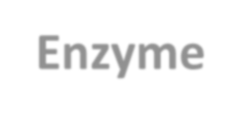





Consumer products in FuturEnzyme
Challenges and bottlenecks for the target sectors and products
Detergent sector
  Enzymes in laundry detergents give the consumers new opportunities to reduce the carbon footprint through:
    Reducing the energy for heating the water during wash at home, by 5-10°C.
  New and improved enzymes (esterase & lipases) are beneficial to remove fatty stains at low wash temperatures (i.e. 20-30°C).
  However, it is very challenging to:
    a) Identify new enzyme candidates, which bring new and promising properties, and
    b) To evaluate if these wild type enzymes are applicable for the target laundry detergents.
Bleach
Substrates
pH
Surfactants
Protease
Temperature
Enzyme
Time
Polymers
Chelators
Solvents

Slide 7



Consumer products in FuturEnzyme
Challenges and bottlenecks for the target sectors and products
Textile sector
  Enzymes (esterases, lipases, oxidoreductases and poly-ester hydrolases) in the textile production unit can have an effective impact to save energy, time and water and reduce CO₂ emissions in three steps:
    The removal of the spinning oils (mineral oil, silicone and fatty acids) during the solvent cleaning step.
    The removal of the dyes after the dyeing/fixing of the textile materials.
    The degradation of textile waste after the end-use.
  The textile’s complexity, in the base material used and different oils & dye recipes & variants in color, make it quite complex to find only one enzyme in their removal and discoloration and neutralization of the wastewater.
Fiber Spinning
Weaving/
Knitting
Solvent Cleaning
Dyeing
Washing
Finishing
Cut & Sew
Fibers
Removal spinning preparations/oils, dyes & auxiliaries
Customers

Slide 8


Consumer products in FuturEnzyme
Challenges and bottlenecks for the target sector and products
Cosmetic sector
  Enzymes can have an effective impact to hydrolyze the long hyaluronic acid in a short defined molecule that is key to the production of anti-ageing cosmetics. Here there are two basic challenges.
    Have a repeatable defined molecule size, because pro-inflammatory responses have been reported for 5-15 kDa fragments.
    For a complex molecule like hyaluronic acid it is not so easy to find an enzyme that cleaves/hydrolyzes at the right place to yield 1-2 kDa fragments.
  This is why we are interested in identifying such an enzyme with which to produce the short-, long- and mid-size molecules. Most likely these will be hyaluronidases.
8300
3-6
200 kDa hyaluronic acid
↓ Biological anti-ageing activity
↓ Low skin penetration
1-2 kDa hyaluronic acid
↑ Anti-ageing activity

Slide 9

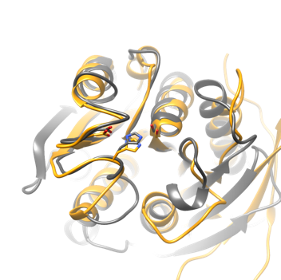
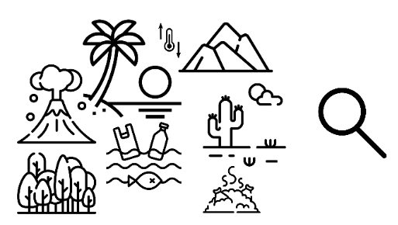


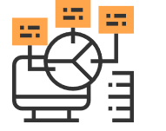
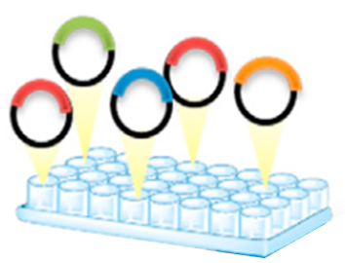
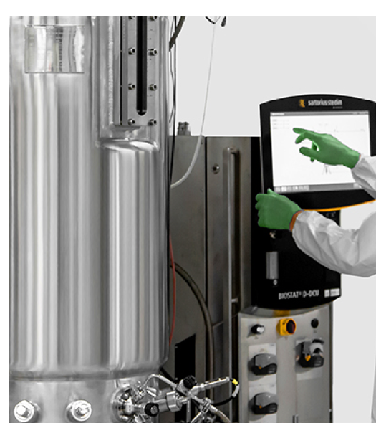


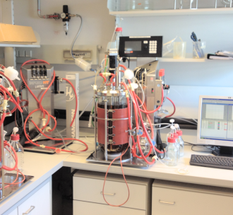
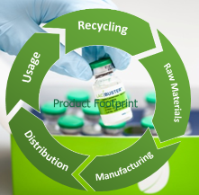
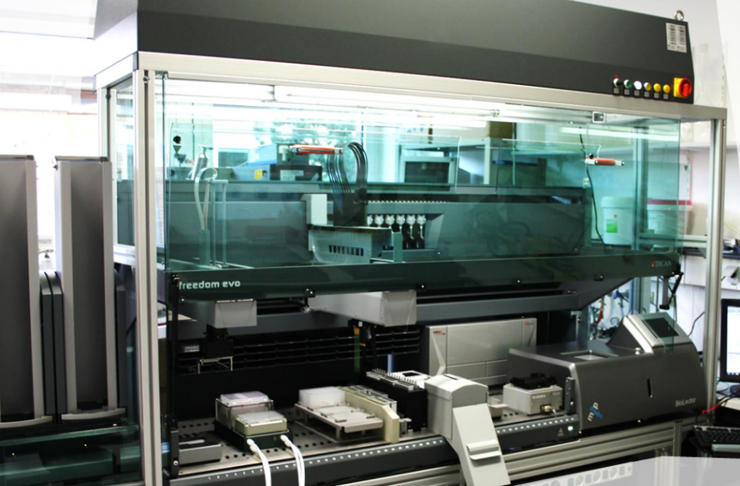
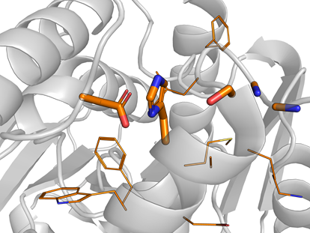



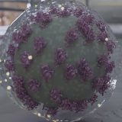

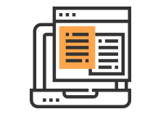
The FuturEnzyme integrated approach
Smart enzyme with
industrial specifications
Consumer and Market Feedback
Life Cycle Assessment
Sequence
www.futurenzyme.eu
Artificial intelligence
(predictive tool)
Genetic
resources
Selection of
“smart” enzymes
Enzyme
improvement
Production
strains
Manufacturing
process
(yield, safety)
Preindustrial
validations
Set-up sophisticated screens:
Functional
Bioinformatics filters
Machine learning filters
Yield and performance
Life Cycle Assessments
Policy, consumers…
HTP (heterologous, cell-free, green chemistry-based-)
production methods
HTP analytics
(real-substrates)
Manufacturers’
requests and
specifications
Disruptive engineering:
Machine learning
Supramolecular
Sustainable production
Optimal formulation
Yield
Yield
Yield
Selection
Decision

Slide 10
The FuturEnzyme expected results
Microbial enzymes (+1,000) with manufacturers’ requirements for «target» products
(detergent, textile, cosmetic)
2 Innovative bioinformatics & computational platforms
2 web-based resources to screen for enzymes required by the target sectors
New enzymes
New tools
FuturEnzyme
“Greening strategies”
Impact on policymaking
Impact on dissemination, communication, exploitation
Impact on training
Impact on recruitment
Impact on gender dimension
Impact on internationalization, cooperation activities
18 Enzymes active and robust enough to outlast the product and process conditions
Dissemination, communication and exploitation
9 Verified and safe enzymes produced at scales required to approach the pre-industrial tests
+1,050 Visualization activities (social media, web, short movie, images, newspaper/TV/radio appearances)
+104 Articles (peer-reviewed and divulgative)
+27 Events organized (workshops, technical courses, scientific seminars, training, conferences, webinars)
+2 Policy briefs
+3 Technical bulletins, briefings
+3 Patents
+130 Events assisted (workshops, technical courses, scientific seminars, training, conferences, webinars)
+1 Customer survey & product test
+2 Policy events & policy briefs
Etc.
4 Products
LHC detergent (+1) with new enzymes.
Enzyme-processed textiles (+3) A4 size.
Leading cosmetic (+1) with hyaluronic products made with enzymes.
Enzymes
Impact on the enzyme supply to industry
Impact on greening consumer products (environmental, economic, employment…)
Impact on the bio-based sector

Slide 11
WP4
The FuturEnzyme workplan
WP1 - Managing and Coordination (58 P/M)
WP9 - Ethics
WP8 - Communication, Dissemination & Exploitation (70.57 P/M)
Enzymes
WP4 (173 P/M)
Enzyme engineering
WP5 (96 P/M)
Machine learning bio-prospecting
Supply best enzymes
WP3 (75 P/M)
WP6 (97.9 P/M)
Activity-based bio-prospecting
WP2 (51 P/M)
WP7 (83 P/M)
Greener products

Slide 12
WP4
The FuturEnzyme key technical indicators
• 1st set greener products (+3)
• 1st set multi-gram enzymes (+9)
• 1st set of priority
enzymes (+180)
• 1st set multi-gram enzymes (+18)
• 1st set enzymes (+50,000)
• 1st set of selected
enzymes (+1,000)
• 2nd set enzymes (+250,000)
• 1st set engineered enzymes (+18)
• HMM & ML tool
M1
M6
M12
M18
M24
M30
M36
M42
M48
Achieved in RP1
For next RPs

Slide 13
The FuturEnzyme deliverables at M18
29 in total
• The FuturEnzyme Portfolio of 1,000 enzyme (recombinant/ native/biomimetic) material, obtained (D4.2)
• Cell-free expression/ reported system, developed (D4.3)
• Biomimetic protease production system, developed (D4.4)
• Project meetings and bodies organization plan (D1.1)
• Set of 250,000 sequences pre-selected (D2.2)
• FuturEnzyme repository for data storage and management (D8.5)
• Plan for using, communication and disseminating project information and knowledge (D8.3)
• Ethics (D9.1-4)
• Set of 180 enzymes for experimental focus (D2.4)
• Data Management Plan (D8.4)
• Initial-term external evaluation reports (D1.2)
• Sequence, activity, and stability datasets from best positive bioresources (D3.4)
• The metadata on expression yield, activity and stability, available (D4.6)
• At least 180 enzymes (recombinant, native, biomimetic) with attractive properties, available (D4.7)
• The shortlist of at least 18 enzymes nominated for engineering (D5.1)
• Report on public, intraconsortium, and interconsortia 18-months events (D8.9)
• Manufacturers’ needs and specifications: protocol (D2.1)
• QR barcoding system, available (D4.1)
• Visual identity guidelines (D8.2)
• Plan for using, communication and disseminating project information and knowledge (D8.3)
• Set of 1,000 enzymes selected using motif screens (D2.3)
• Preliminary exploitation plan (D8.6)
• FuturEnzyme project leaflet and brochure (D8.7)
• Bio-resources prepared and exchanged (D3.1)
• Standard assays, analytics and calculations for monitoring enzymatic performance (D3.2)
• FuturEnzyme website (D8.1)
• Set of 100 best clones, 10 isolates, and 10 enzymes shortlisted for sequencing or transfer to WP2 (D3.3)
M2
M4
M6
M8
M10
M12
M14
M16
M18

Slide 14
The FuturEnzyme milestones at M18
15 in total
• Set of 500 computational driven sequences selected (MS6)
• First round of functional screens completed (MS9)
• First round of sequencing completed (MS10)
• Supramolecular engineering: first round completed (M17)
•First set of PluriZymes
(MS18)
• Characteristics, first 3 multienzyme blends (M15)
•Genetic engineering: first round completed (MS16)
• First version database for data management completed (MS30)
• The first sampling campaign completed (M11)
• Characteristics, first 180 enzymes (WP2-top ones) (MS14)
• Set of 50,000 homology driven sequences pre-selected (MS5)
• First Consortium General Assembly convened (MS1)
• First version FuturEnzyme website (MS29)
• First set of 250 enzymes expressed at mg scale (MS12)
• First set of benchmark enzyme materials available (MS13)
M2
M4
M6
M8
M10
M12
M14
M16
M18

Slide 15
FuturEnzyme
Technologies of the FUTURe for low-cost ENZYMEs for environment-friendly products
WP1 – Managing and Coordination
FuturEnzyme: First Reporting Period
Start date: 1 June 2021 - End date: 31 May 2025 Proposal number: 101000327 - Consortium: 16 partners
Requested EU Contribution: 5,995,035.13 €
Project funded by the European Union’s Horizon 2020
Research and Innovation Programme under grant agreement No [101000327]

Slide 16
WP1 - Managing and Coordination
OBJECTIVE
  Management of the project; EC-contact/funding issues management; synergies with sister projects; communication with the Advisory Board (AB)
  TASKS
    Technical, administrative and financial management (M1 - M48) (TASK 1.1)
    Confidentiality legal documents Inter-Consortia for establishing synergies (M1 - M48) (TASK 1.2)
WORK DONE
  Project's organization and management at all levels
  Communication with the European Union (Project Officers), AB members and the 3 sister projects
M1
M6
M12
M18
M24
M30
M36
M42
M48
Task 1.1
Task 1.2

Slide 17
WP1 - Partners involved
WP1 lead
CSIC, Agencia Estatal Consejo Superior de Investigaciones Científicas (10.79/35 PM)
CLIB, Cluster Industrielle Biotechnologie e.V. (1.04/2 PM)
WP1 contributing partners
ITB, Consorzio Italbiotec (0.43/2 PM)
BSC, Barcelona Supercomputing Center (0.41/1 PM)
UDUS, Heinrich-Heine Universitaet Duesseldorf (0.31/1 PM)
Bio_Ch, Bio-Chem Solutions SRL (0.5/1 PM)
UHAM, Universitaet Hamburg (0/1 PM)
EUC, Eucodis Bioscience GMBH (0.42/2 PM)
CNR, Consiglio Nazionale Delle Ricerche (2/4 PM)
INOFEA, Inofea AG (0.68/1 PM)
FHNW, Fachhochschule Nordwestschweiz (0.69/1 PM)
EVO, Evonik Operations GMBH (1.1/3 PM)
IST-ID, The Association of Instituto Superior Técnico For Research and Development (0.46/1 PM)
HENKEL, Henkel AG & Co KGaA (0.63/1 PM)
SCHOELLER, Schoeller Textil AG (0.57/1 PM)
BANGOR, Bangor University (0.1/1 PM)

Slide 18
Task 1.1: How to achieve objectives, and work done
Agreements
  GA signed, 05.05.2021
  Consortium Agreement, 26.05.2021
A Project Manager hired, 01.06.2021, and CSIC’s online platform set-up
Pre-financial payment (2,897,600.31€) received, 18.06.2021, and transferred (29.06.2021; 06.2022).
7 meetings for project implementation:
  3 with Project Officer (09.2021, 04.2022, 09.2022).
  The KoM (online, 08.06.2021), the 12M General Assembly (hybrid, Madrid, 31.05-01.06.2022), and the 6M and 18M Executive Committee meetings (online, 08.11.2021, 14.11.2022)
4 Task Forces annual meetings:
  The Gender, Rights and Ethical (online, 08.06.2021, hybrid, 01.06.2022)
  Exploitation and Innovation (online, 08.06.2021, hybrid, 01.06.2022)
+31 Online meetings arranged between partners when convenient (5 with sister projects).

Slide 19
Task 1.1: The FuturEnzyme Task Forces
Dissemination, Communication
and IP¹
Data
Management ¹
Consumer¹
Exploitation and Innovation¹
Gender, Rights and Ethical¹
Lead: Ilaria Re (f; ITB) and Manuel Ferrer (m; CSIC)
Monitoring: continuous
Lead: Patricia Molina (f; CSIC)
Monitoring: continuous
Lead: Ilaria Re (f; ITB) and Manuel Ferrer (m; CSIC)
Monitoring: continuous
Lead: Markus Müller (m; CLIB) and Manuel Ferrer (m; CSIC)
Monitoring: 12-month regularity
Lead: Ilaria Re (f; ITB) and Manuel Ferrer (m; CSIC)
Monitoring: 12-month regularity

Slide 20
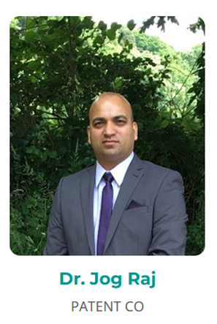
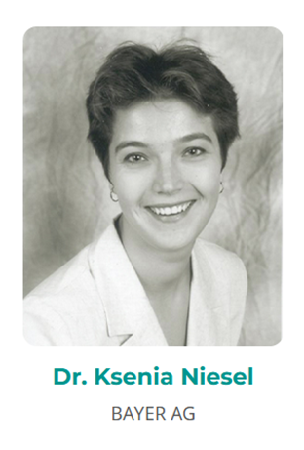
Task 1.1: The FuturEnzyme Advisory Board
Non-disclosure agreements (NDAs) signed on July 2021
02 November 2022
Stakeholders¹
Stakeholders¹
1) Interest in transparency and traceability.
2) Use of hit enzymes out of FuturEnzyme manufacturers’ interests.
3) Offering the enzymes to other industries.
4) Importance of having a strict price control while producing enzymes.
5) Presenting the enzymes in reputed congresses.
1) Relevance of Nagoya protocol.
2) Reinforce the access to the metadata.
3) Importance of eukaryotic systems for enzyme production.
4) Possibility to check the enzymes by Bayer

Slide 21

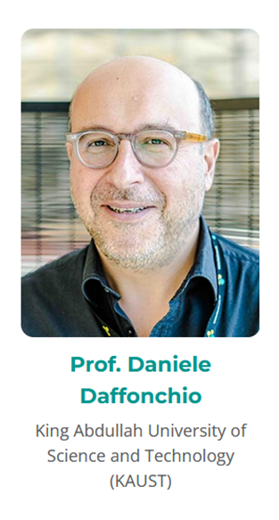
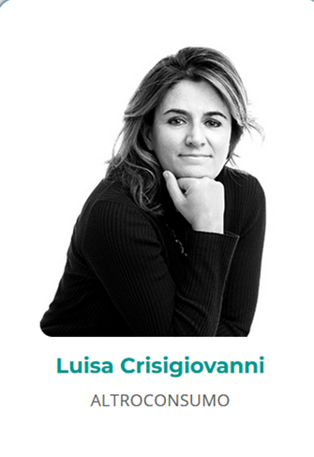
Task 1.1: The FuturEnzyme Advisory Board
Non-disclosure agreements (NDAs) signed on July 2021
20 October 2022
20 October 2022
18 October 2022
Scientific¹
Scientific¹
Consumers¹
1) Reinforce production, improve innovation in the expression systems to equilibrate the sophisticated bio-prospecting pipeline.
1) Relevance of Nagoya protocol.
2) Reinforced the criteria to manage the search of best enzymes amongst the thousands of proteins we started looking for our hits
1) Adequate labelling of the final products.
2) Importance of messages in divulgative articles.
3) Collaborations with Consumer's Rights Organisation.
4) Importance of consumer testing with benchmark products.

Slide 22




Task 1.2: How to achieve objectives and work done
Cluster Enzymes for greener products (FNR-16-2020)
OXIPRO (Gro E. Kjæreng Bjerga, Norway, grbj@norceresearch.no)¹:
  Topic: Transition towards friendly consumer products by co-creation of an oxidoreductase foundry (ID 101000607)
  Development of oxidoreductases (which contribute to create value from waste, replacing harmful oxidisers (detergents), and enhancing appearance, quality, and durability of consumer products) by efficient computing and the newest biotechnology to reduce time-to-market.
RadicalZ (Aurelio Hidalgo, Spain, ahidalgo@cbm.csic.es)¹:
  Topic: Rapid discovery and development of enzymes (oxidoreductases) for novel and greener consumer products (ID 101000560)
  New enzymes, glycosides, bio-based thickeners, natural antioxidants and fragrances for application in more environment-friendly washing agents, nutraceuticals and cosmetics by i) developing new droplet microfluidic tools and ii) user-friendly software solutions based on machine learning.
EnXylaScope (Carolina Peñalva, Spain, carolina.penalva@aitiip.com)¹:
  Topic: Mining microbes and developing advanced production platform for novel enzymes (xylanases) to rapidly unleash xylans’ potential in a scope of products for the consumer market (ID 101000831)
  Novel enzymes for debranching xylan, whose properties will make it suitable as ingredient for consumers’ products in cosmetics, personal care and nutraceutical sectors.

Slide 23
Task 1.2: How to achieve objectives and work done
Cluster Enzymes for greener products (FNR-16-2020)
The first meeting, 14.10.2021, together with REA (Unit B3) and POs. Actions include:
  Cluster’s newsletter, The Active Site
  Policy Working Group (PWG), for preparation of joint policy briefs
  Articles, e.g. in Ambienta journal (with EnXylaScope), EP-Pred (with OXIPRO)
  A roadmap with Report on actions
  Research collaborations, e.g. Biocontainers
Future actions, include:
  Campaigns to reach European and non-European, consumer and social audience
  Common platform for open science deposits. FuturEnzyme and OXIPRO already using Zenodo
  Webinars, courses, workshops, training events, round tables/joint policy meetings (e.g. February-March 2023)
  Compile inputs to public consultations, technological implementations, gaps

Slide 24
WP1 – Deliverables and milestones
• Project meetings and bodies organization plan (D1.1)
• Initial-term external evaluation reports (D1.2)
• Mid-term external evaluation reports (D1.3)
• Final external evaluation reports (D1.4)
• Confidentiality legal documents interconsortia (D1.5)
• First Consortium General Assembly convened (MS1)
• First inter-consortia confidentiality agreements (MS4)
• Project completed (MS3)
• Mid-term review (MS2)
M1
M6
M12
M18
M24
M30
M36
M42
M48
Achieved in RP1
For next RPs
Deliverable
Milestone
*

Slide 25
WP1 – Expected and achieved outputs
Key bullet points
Key bullet points (non-scientific)
  A total of 20.13 P/M (out of 58 total, a 34.71%) at M18.
  The work plan is proceeding as planned (see Table 1.1)
        Table 1.1. Brief summary of clear and measurable details and achievements in WP1 (as in the GA)
Name of activity | Achieved | Achievement (%) | Status
Project meetings and bodies organization plan (D1.1) | Yes | 100% | Completed
Initial-term external evaluation reports (D1.2) | Yes | 100% | Completed
Mid-term external evaluation reports (D1.3) | Open | 0% | Open
Final external evaluation reports (D1.4) | Open | 0% | Open
Confidentiality legal documents inter-consortia (D1.5) | Partially | 50% | Open
Deliverables (2, at M18) | Yes | 100% | Completed
Milestones (1, at M18) | Yes | 100% | Completed

Slide 26
WP1 – Future actions
Future actions (six months ahead):
  24-month General Assembly (6-7 July 2023, Hamburg, Germany) preparation.
  Cluster meetings regarding policy brief, newsletter, joint publications, workshops, courses, etc.
  Consortia workshops, courses, conference, etc.
  Confidentiality legal documents inter-consortia, if needed.

Slide 27
WP1 – Deviations
Two budget deviations
  Budget change request by CNR
  Budget re-allocation for recruitment at CSIC-IQFR
Inter-consortia confidentiality agreements
  The signing of this framework agreement to share data and materials for joint developments may not be feasible because of sensitive information to be shared
  We will continue strengthening our cooperation through the Cluster and through scientific collaborations

Slide 28


FuturEnzyme
Technologies of the FUTURe for low-cost ENZYMEs for environment-friendly products
WP2 – Machine learning enzyme bio-prospecting integrated into an industrial context
FuturEnzyme: First Reporting Period
Start date: 1 June 2021 - End date: 31 May 2025
Proposal number: 101000327 - Consortium: 16 partners
Requested EU Contribution: 5,995,035.13 €
Project funded by the European Union’s Horizon 2020
Research and Innovation Programme under grant agreement No [101000327]

Slide 29
WP2 - Machine learning enzyme bio-prospecting
integrated into an industrial context
OBJECTIVE
  To pre-select enzymes meeting products’ requirements by bioinformatics and supercomputing pipelines:
      Public and consortium sequence repositories
      Knowledge of the needs and requirements of manufacturing companies
      Meta-data analysis
  TASKS
    Compile the on-demand manufacturers’ needs and specifications (M1 - M6) (TASK 2.1)
    Pre-selecting candidate sequences through extensive homology search (M1 - M48) (TASK 2.2)
    Motif buildup for massive and smart search of enzymes fitting manufacturers’ needs (M1 - M42) (TASK 2.3)
    Iterative and decision-making hierarchical procedure for speed up enzyme discovery (M3 - M48) (TASK 2.4)
M1
M6
M12
M18
M24
M30
M36
M42
M48
Task 2.1
Task 2.3
Task 2.2
Task 2.4

Slide 30
WP2 - Machine learning enzyme bio-prospecting
WORK DONE
  Task 2.1: Detailing the manufacturers' needs, specifications and priorities and a state-of-art analysis:
    Products
    Requests
    Innovation
    Priority enzymes to be targeted
    Specifications that enzymes should meet
    Decision taken strategies
  Task 2.2: Implementing and using at least five bioinformatics and computational methods to bio-prospect for, and pre-select the target enzymes from:
    +900 Giga-bytes and +400 million sequences generated in the project
    +1 Billion sequences in public repositories
  Tasks 2.3-2.4: Development of novel algorithms and biocontainers for enzyme bio-prospecting through:
    Integrating experimental meta-data (WP4 & WP5)
    Establishing novel consensus machine learning predictors and core software

Slide 31
WP2 - Partners involved
WP2 lead
BSC, Barcelona Supercomputing Center (11.45/32 PM)
WP2 contributing partners
CSIC, Agencia Estatal Consejo Superior de Investigaciones Científicas (1.61/3 PM)
EVO, Evonik Operations GMBH (0.2/1 PM)
UDUS, Heinrich-Heine Universitaet Duesseldorf (0.68/1 PM)
HENKEL, Henkel AG & Co KGaA (1.94/2 PM)
UHAM, Universitaet Hamburg (0/6 PM)
SCHOELLER, Schoeller Textil AG (0.74/4 PM)
BANGOR, Bangor University (0/2 PM)

Slide 32



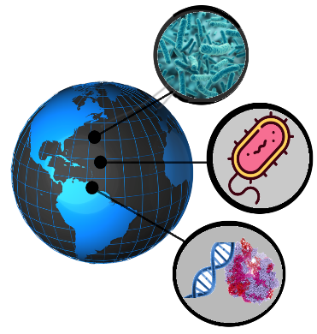

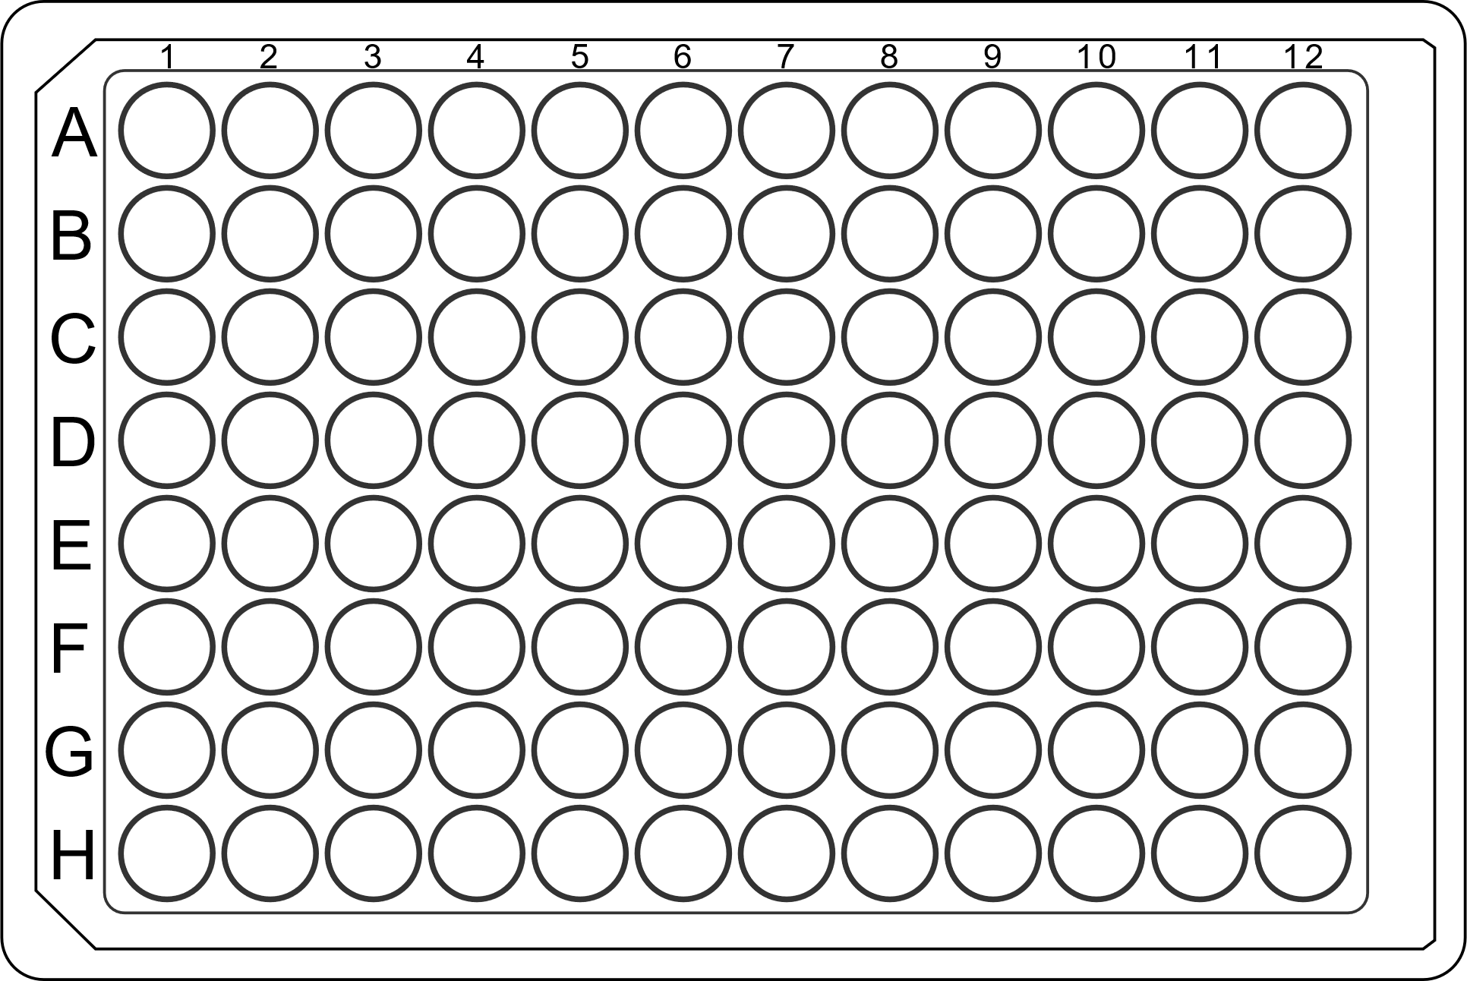




WP2 - Interactions
Machine learning bio-prospecting
Fermentation, DSP, Formulation Development
WP2
WP6
Larger scale and formulated enzymes
Feedback
Activity-based bio-prospecting
WP3
WP5
WP7
Enzyme engineering
Industrial Application Tests
WP4
Enzymes
Enzymes for small scale application tests

Slide 33
Task 2.1: Compile the on-demand manufacturers’ needs and specifications (M1 – M6)
Objective
  To set up a protocol specifying the manufacturers' needs and specifications and the decision-taken strategies to select best enzymes for the target application

Slide 34
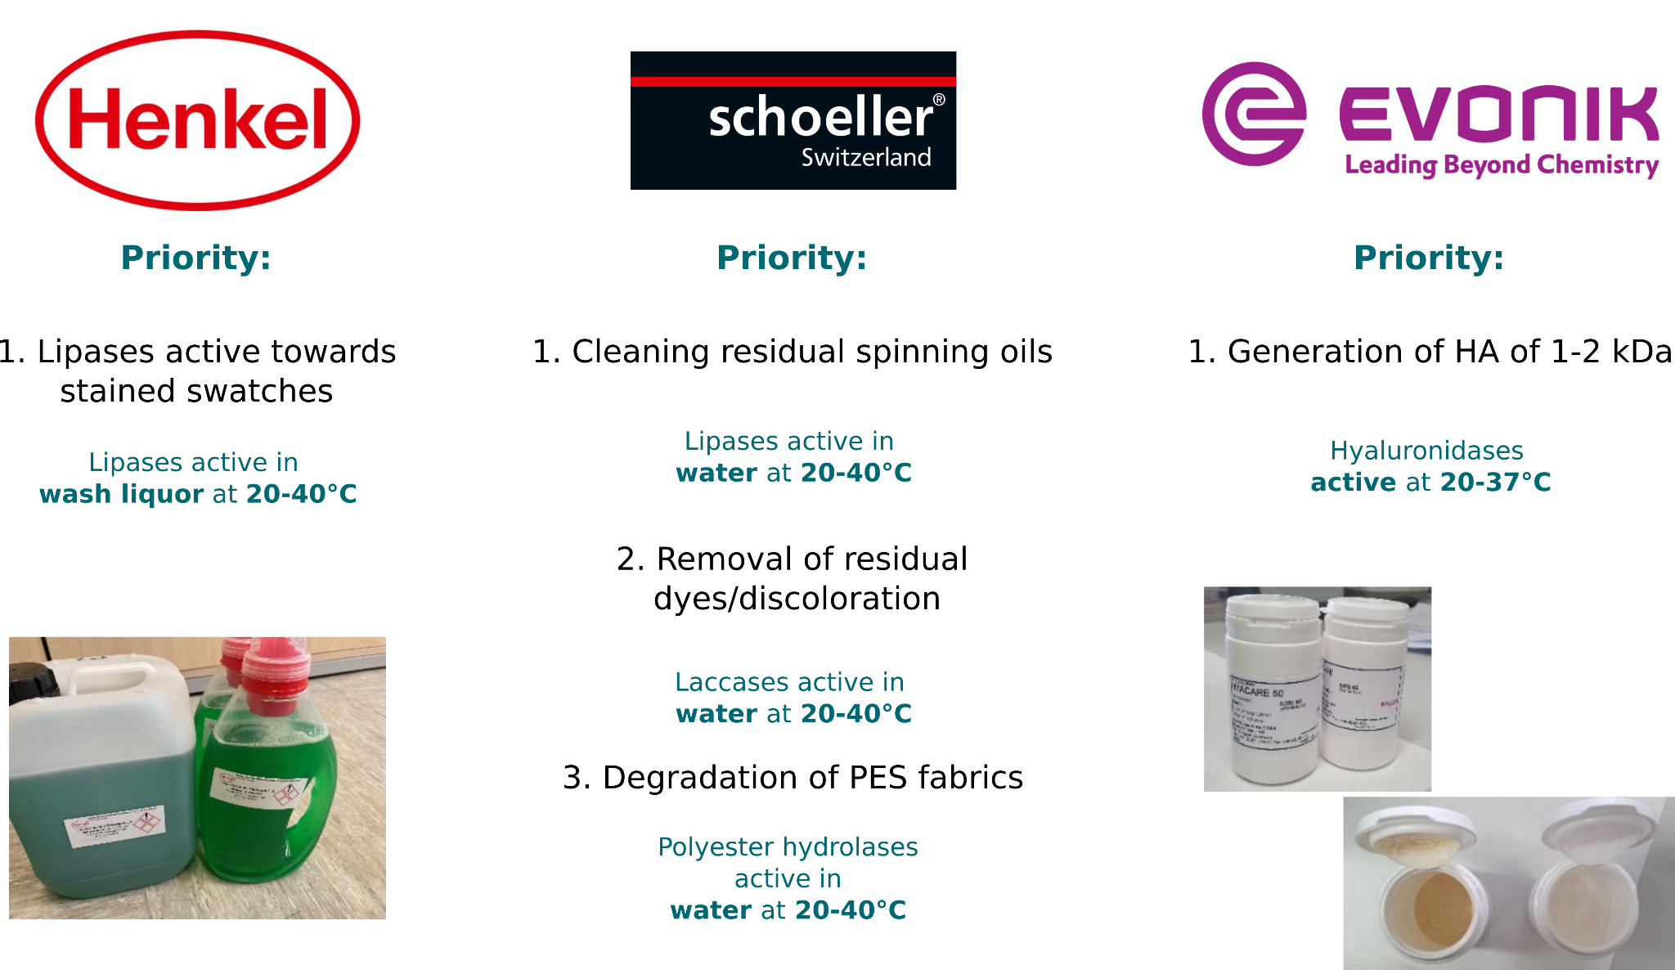
Task 2.1: Explanation of the work carried
Progress undertaken and outputs achieved
Protocol specifying HENKEL, EVONIK and SCHOELLER' needs completed
State of the art analysis
The decision-taken strategies to select best enzymes for the target applications established

Slide 35
Task 2.2: Pre-selecting candidate sequences through extensive homology search
Objective
  To develop and use complementary homology search to recover at least 250,000 full-length candidate sequences encoding enzymes relevant to the project target applications

Slide 36
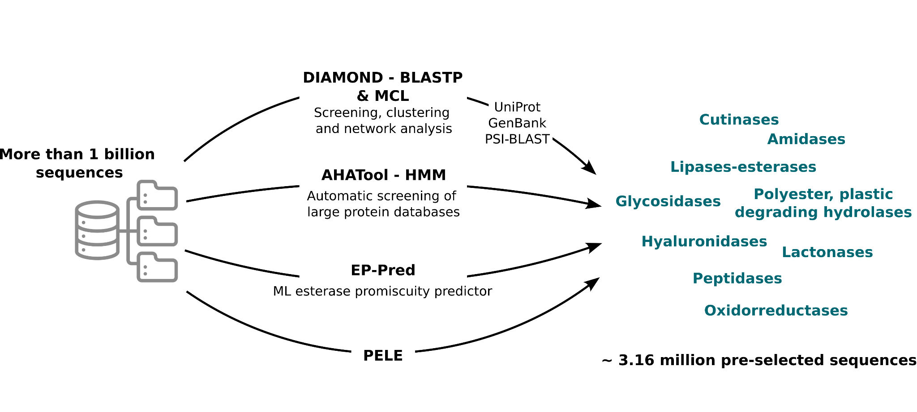
Task 2.2: Explanation of the work carried
Progress undertaken and outputs achieved
Pre-selecting candidate sequences through extensive homology search
  After screening more than 1 billion sequences, about 3.16 million sequences encoding target enzymes were retrieved and pre-selected.

Slide 37
Task 2.3: Motif buildup for massive and smart search of enzymes fitting manufacturers’ needs
Objective
  To integrate meta-data and bioinformatics or computational motifs and descriptors to pre-select 1,000 candidate sequences encoding enzymes possibly fulfilling manufacturer specifications

Slide 38
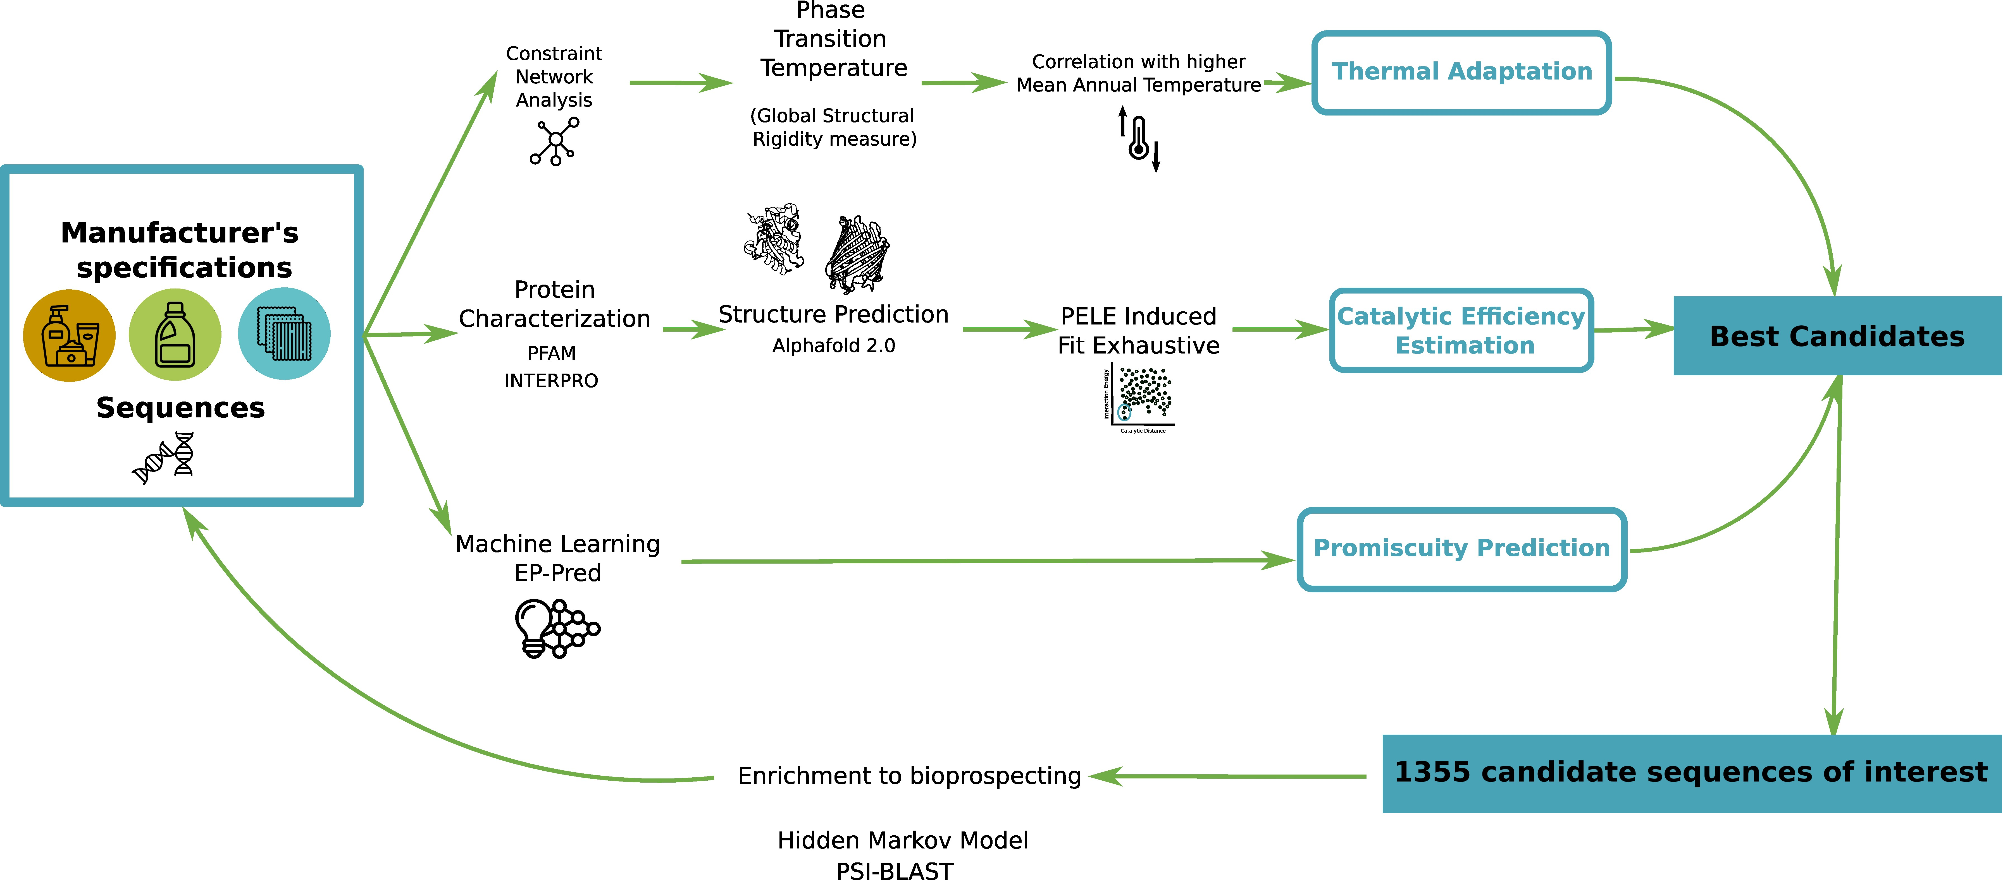
Task 2.3: Explanation of the work carried
Progress undertaken and outputs achieved

Slide 39
Task 2.4: Iterative and decision-making hierarchical procedure for speed up enzyme discovery
Objective
  To develop a new predictive, user-friendly and open-source technology to rapidly bio-prospect sequences encoding targeted enzymes, with high probabilities of high activity with specific substrates and enhanced stabilities

Slide 40
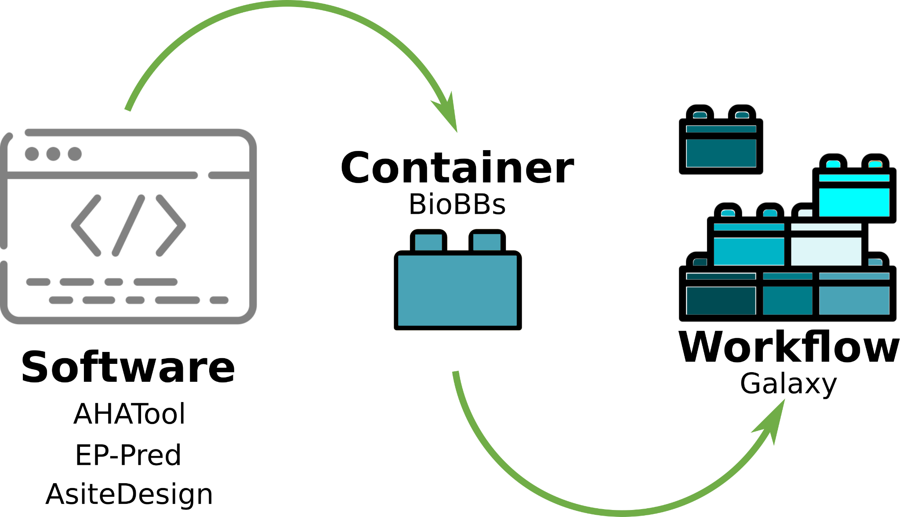
Task 2.4: Explanation of the work carried
Progress undertaken and outputs achieved
  Several biocontainers have already been developed in OXIPRO and FuturEnzyme for bio-prospecting and engineering, including the AHATool, EP-Pred and AsiteDesign ones.
  The development of two of them, EP-Pred and AsiteDesign, have represented two joint publications between the FuturEnzyme and the OXIPRO consortiums.

Slide 41
WP2 – Deliverables and milestones
• Manufacturers’ needs and specifications: protocol (D2.1)
Updated on month 19 (December 2022)
• Set of 250,000 sequences pre-selected (D2.2)
Updated on month 19 (December 2022)
• Online web tool for performing HMM searches (D2.5)
• Online predictive web tool to search enzymes with manufacturers’ specifications (D2.6)
• Set of 1,000 enzymes selected using motif screens (D2.3)
Updated on month 19 (December 2022)
• Set of 180 enzymes for experimental focus (D2.4)
Updated on month 19 (December 2022)
• Set of 50,000 homology driven sequences pre-selected (MS5)
• First version of the HMM online web completed (MS7)
• First version of the predictive online web completed (MS8)
• Set of 500 computational driven sequences selected (MS6)
M1
M6
M12
M18
M24
M30
M36
M42
M48
Achieved in RP1
For next RPs
Deliverable
Milestone

Slide 42
WP2 - Expected and achieved outputs
Key bullet points
Key bullet points (non-scientific)
  A total of 16.62 P/M (out of 51 total, a 32.59%) at M18.
  The work plan is proceeding as planned (see Table 2.1)
        Table 2.1. Brief summary of clear and measurable details and achievements in WP2 (as in the GA)
Name of activity | Achieved | Achievement (%) | Status
1 Protocol with manufacturers’ needs & specifications (D2.1) | Yes | 100% | Completed
250,000 Sequences pre-selected (D2.2) | Yes | 1300% | Open
1,000 Enzymes selected using motif screens (D2.3) | Yes | 140% | Open
180 Enzymes for experimental focus (D2.4) | Yes | 377% | Open
Online web tool for performing HMM searches (D2.5) | Partially | 40% | Open
Online predictive web tool to search project enzymes (D2.6) | Partially | 20% | Open
Deliverables (4, at M18) | Yes | 100% | Completed
Milestones (2, at M18) | Yes | 100% | Completed

Slide 43
WP2 - Expected and achieved outputs
Key bullet points
Key bullet points (scientific)
  Technical requirements and specifications for the product benchmarks and enzymes, compiled.
  Decision taken strategies for enzyme pre-selection, implemented.
  A hierarchical approach for enzyme bio-prospecting applied in several use cases, developed.
  EP-Pred, an enzyme substrate scope predictor software, developed
  Meta-data from enzymes characterized in WP4 and WP5, integrated.
  Novel algorithms, using consensus machine learning predictors, for enzyme bio-prospecting (published in fall 2022), implemented.
  A unique platform for enzyme bio-prospecting and engineering that facilitate a wide user of the scientific algorithmic achievements. Notice, that this platform is being developed jointly with another of the FNR-16-2020 projects, our sister project OXIPRO, thus maximizing the efforts in this call.

Slide 44
WP2 – Future actions
Future actions (six months ahead)
  Second round of enzyme bio-prospecting (already ongoing); based on the initial results in the experimental validation for the pre-selected enzymes, we are now running a second round to refine the search.
  Expansion of the machine learning bio-prospecting tools; we will aim at performing additional proofs of concepts and applied applications of our consensus machine learning (EP-Pred) predictor.
  Development of the platform; as stated, the main development of the platform will involve the second part of the proposal where we will integrate the different bio-containers being developed into a graphical web application (Galaxy).
  Evaluate correlations between computationally predicted parameters, such as the number of catalytic events, and experimental values (catalytic turnover, substrate affinity, etc.), to guide robust pre-selection based on those calculations.

Slide 45
WP2 – Deviations
Deviations
  No deviations found in the activities planned in the GA, and no mitigation actions are required.
  That said, several deliverables, namely, D3.1-D3.3, were updated in December 2022 with the approval of the Project Officer (22 November 2022).

Slide 46
FuturEnzyme
Technologies of the FUTURe for low-cost ENZYMEs for environment-friendly products
WP3 – Activity-based bio-prospecting for enzymes
FuturEnzyme: First Reporting Period
Start date: 1 June 2021 - End date: 31 May 2025 Proposal number: 101000327 - Consortium: 16 partners
Requested EU Contribution: 5,995,035.13 €
Project funded by the European Union’s Horizon 2020
Research and Innovation Programme under grant agreement No [101000327]

Slide 47
WP3 - Activity-based bio-prospecting for enzymes
OBJECTIVES
Collect and naïve screen bio-resources and generate sequence data to pre-select the target enzymes:
  Cultured microbial isolates, representing novel lineages
  Expression libraries from DNA from uncultivable microbial communities
  Genomes of microbial isolates
  Shotgun sequences of microbial communities
  Etc.
  TASKS
    Task 3.1 Exploitation of the FuturEnzyme bio-resource collections M1-M24
    Task 3.2 Sampling extreme environments for generating new microbial bio-resources M6-M30
    Task 3.3 Next Generation Sequencing for generating sequences of target enzymes M1-M36
M1
M6
M12
M18
M24
M30
M36
M42
M48
Task 3.1
Task 3.2
Task 3.3

Slide 48
WP3 - Activity-based bio-prospecting for enzymes
WORK DONE
  Task 3.1: Exploitation of the FuturEnzyme bio-resource collections :
    Enzymes, 1,428
    Isolates, 1,492, with 223 genome-sequenced
    Metagenomic libraries, 35
    Enrichment cultures, 52
    Shotgun sequencing data, 64
  Task 3.2: Sampling extreme environments for generating new microbial bio-resources:
    Raw environmental samples: 51 new samples
    Isolates: 208 new isolates from 28 different locations
    Clone metagenomic libraries: 7 fosmid libraries, combined, 2 M clones
    Enrichment cultures: 42 enrichment cultures
  Task 3.3: Next Generation Sequencing for generating sequences of target enzymes :
    Genomes of 22 new isolates
    Shotgun metagenome sequences, 54
    The sequences of enzymes, 257

Slide 49
WP3 partners
WP3 lead
BANGOR, Bangor University
WP3 contributing partners
CSIC, Agencia Estatal Consejo Superior de Investigaciones Científicas
UDUS, Heinrich-Heine Universität Düsseldorf
UHAM, Universität Hamburg
CNR, Consiglio Nazionale Delle Ricerche
IST-ID, The Association of Instituto Superior Técnico For Research and Development

Slide 50
WP3 - Interactions
Machine learning bio-prospecting
Fermentation, DSP, Formulation Development
WP2
WP6
Larger scale and formulated enzymes
Feedback
Activity-based bio-prospecting
WP3
WP5
WP7
Enzyme engineering
Industrial Application Tests
Enzyme candidates with verified activities, new isolates and libraries. (Meta)genomic data
WP4
Enzymes
Enzymes for small scale application tests

Slide 51
Task 3.1: Activity-based bio-prospecting for enzymes (M1 – M36)
Objective
  To deliver a set of positive bio-resources containing the target activities best matching industrial requirements to proceed with sequencing and characterization
Subjected to screens and assays to
feed the data to WP2, WP4 (and WP5)
1428 enzymes
1492 isolates
52 enrichment cultures,
35 metagenomic libraries
223 genomes
64 shotgun metagenome sequences
Progress and outputs achieved
  Establishing standardized screening protocols and workflows
  Distribution and exchange bioresources (libraries, isolates, etc.)
  State of the art enzymatic screening was applied, e.g.
    Robotics (colorimetric, etc.)
    Microfluidics
    In vitro translation
    LC (MS)
    Preparation of the protocol accommodating the manufacturers’ demands and specifications

Slide 52
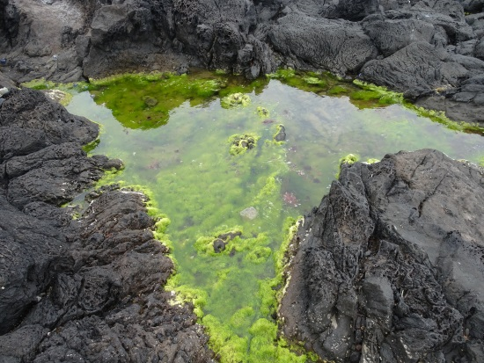
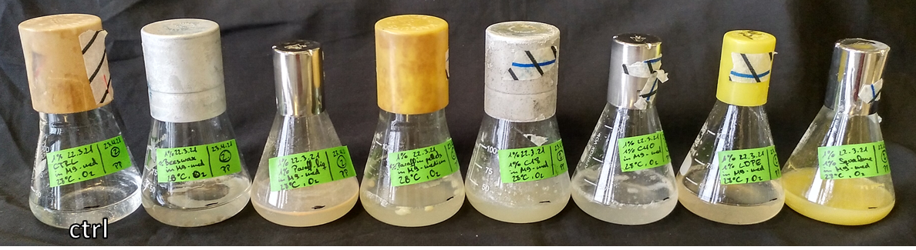
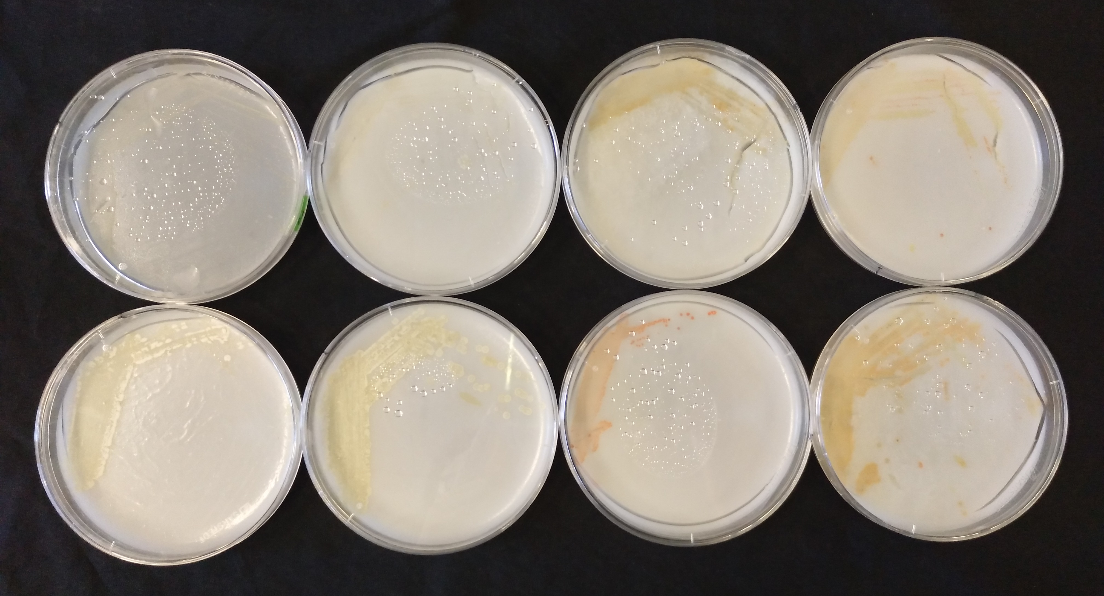
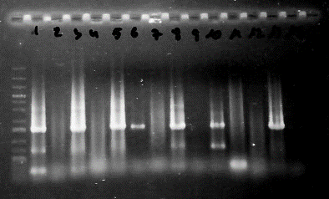


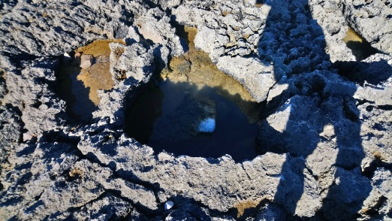
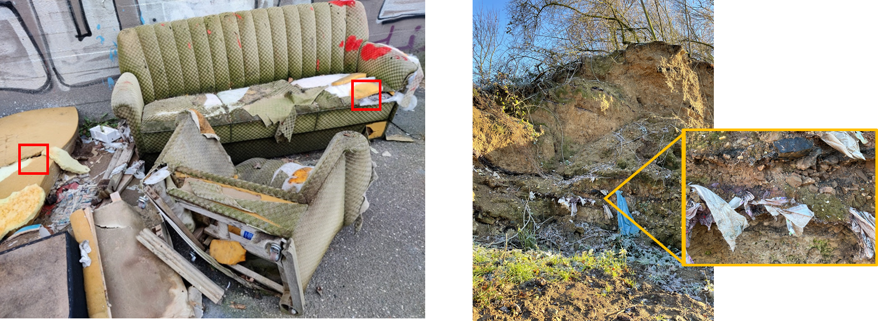
Task 3.2: Sampling extreme environments for generating new microbial bio-resources (M6 – M30)
Objective
  New sampling activities to generate new clones, isolates, enrichments and sequences to feed the Task 3.1, as well as WP2 and WP4
Progress and outputs achieved
  Samples’ collection (51) from new distinct geographical locations
  208 new isolates
  7 new fosmid libraries produced (ca 2,000,000 clones in total)

Slide 53
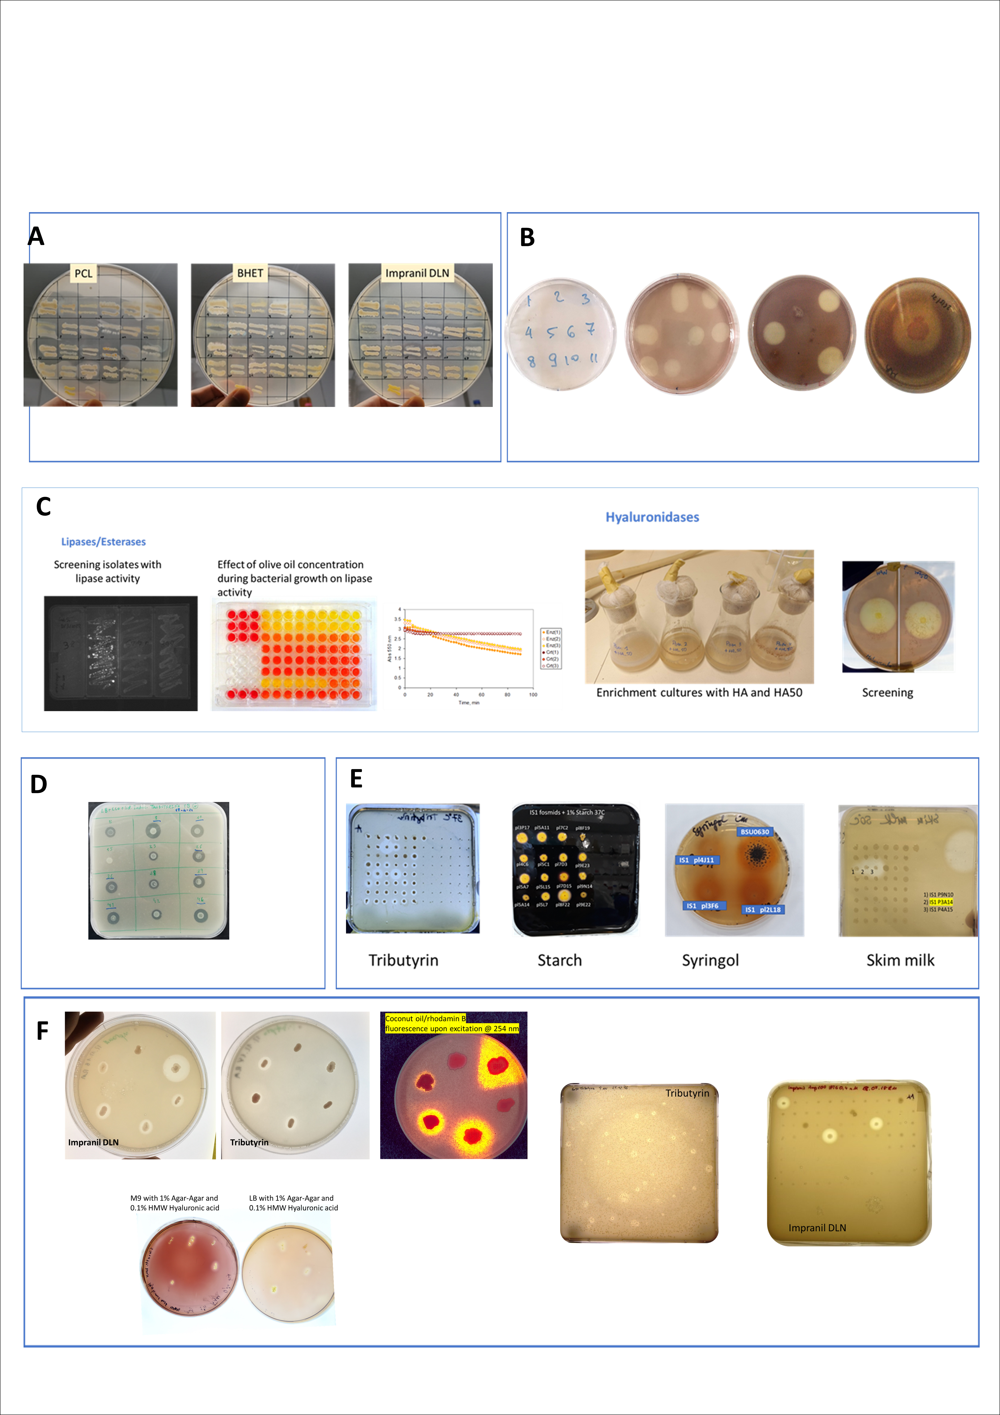
Tasks 3.1-3.2: Explanation of the work carried
Progress undertaken and outputs achieved
A broadest coverage of functional methods to screen diverse bio-resources
Example of functional screening
Enrichment cultures using Hyacare HMW and Hyacare50

Slide 54
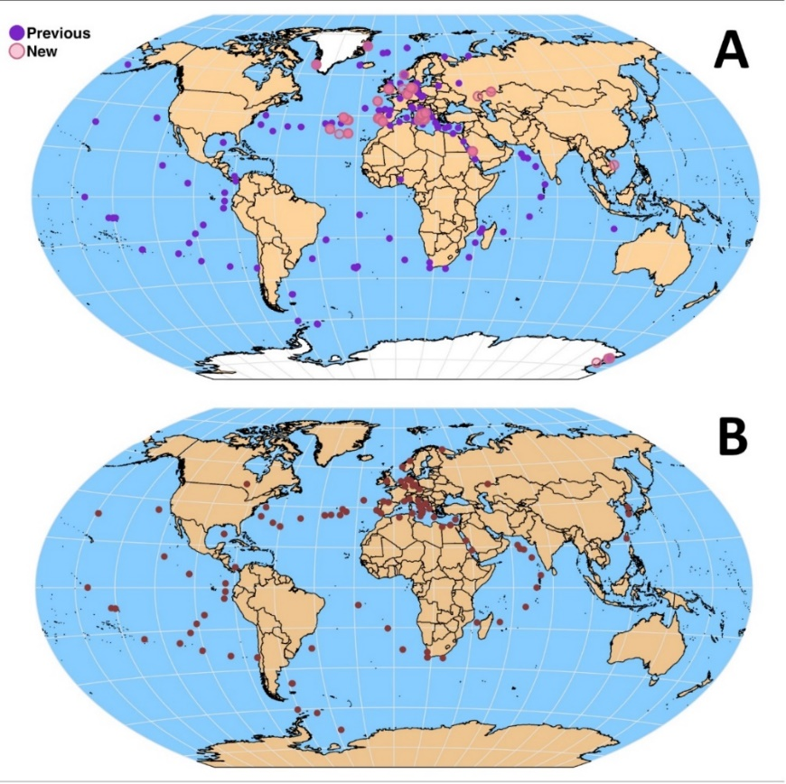
Tasks 3.1-3.2: Explanation of the work carried
Progress undertaken and outputs achieved
A broadest coverage of microbial biodiversity from geographically and geochemically distinct environments:
Geography of FuturEnzyme resources
Geography of FuturEnzyme positive resources
The map includes the +293 different locations from where bio-resources have been generated
The map includes the +119 environmental sites from positive bio-resources have been found

Slide 55
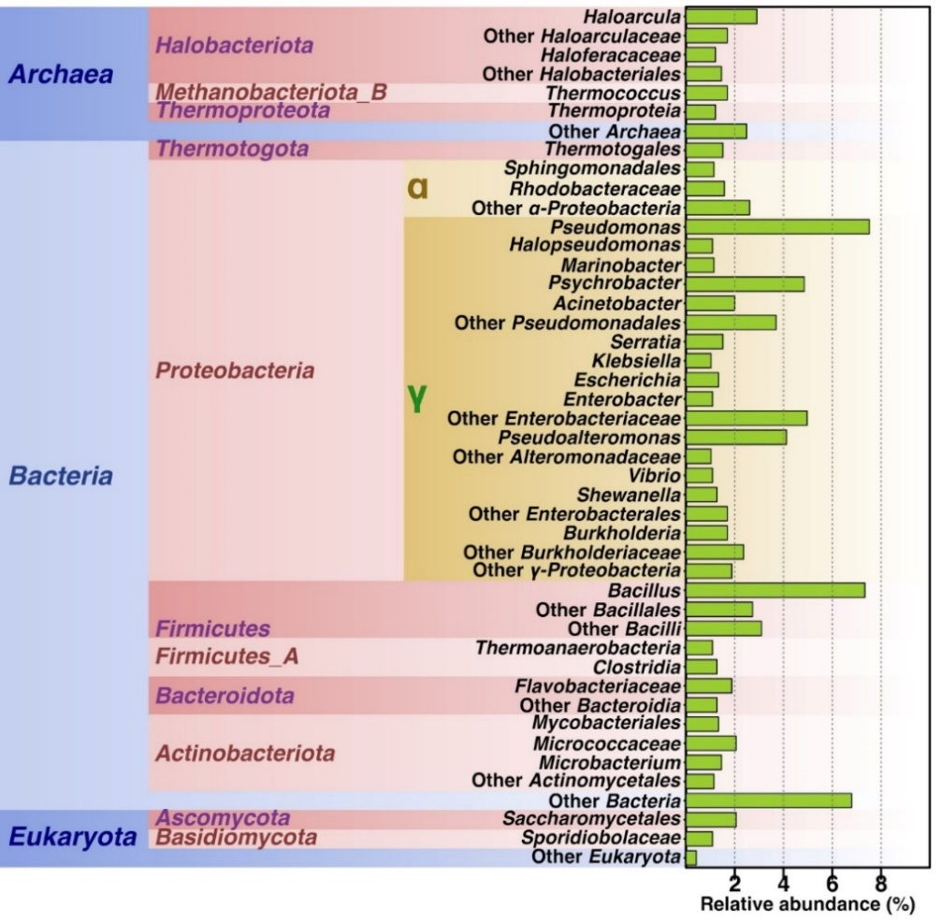
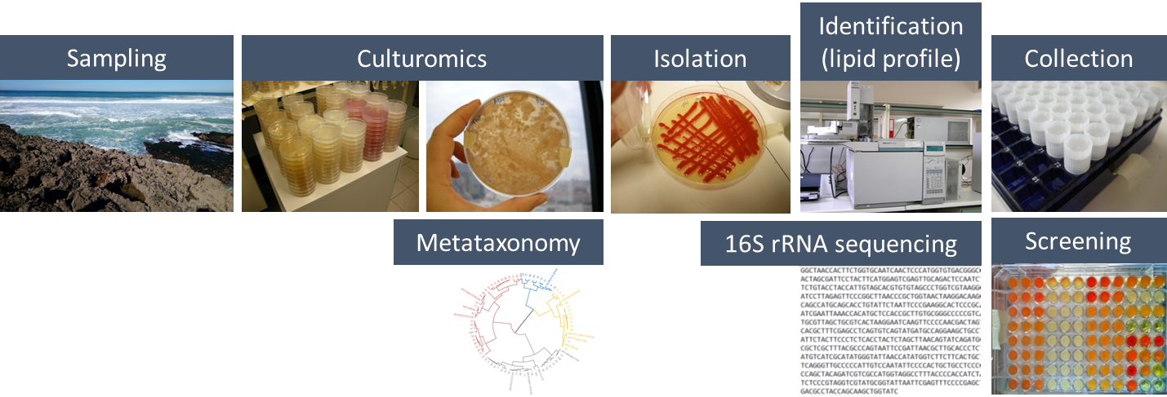
Tasks 3.1-3.2: Explanation of the work carried
Progress undertaken and outputs achieved
A broadest coverage of microbial biodiversity from geographically and geochemically distinct environments:
Taxonomic origin of FuturEnzyme bioresources
Workflow of the cultivation strategy: from sampling, to cultivation to screen new isolates
The +1700 isolates, assigned to +858 species, collected, isolated and partially screened and sequenced

Slide 56
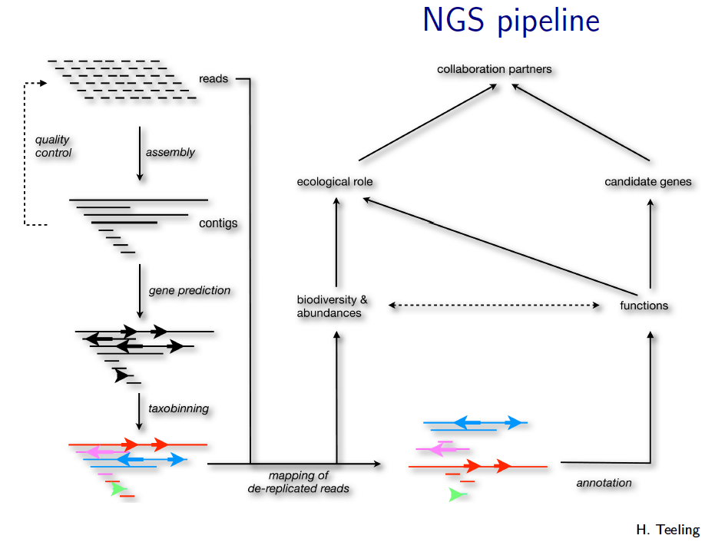
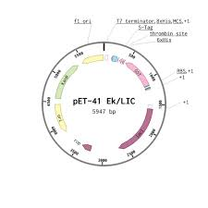

Task 3.3: Next Generation Sequencing for generating sequences of target enzymes (M1 – M36)
Objective
  Next Generation Sequencing for generating sequences of target enzymes
Progress and outputs achieved
  The genomes of 22 microbial isolates.
  The metagenomes of 54 samples (DNA from raw samples and enrichment cultures).
  The sequences of 257 enzymes: i) 185 enzymes with esterase, lipase, or polyester degrading hydrolase activities; ii) 70 enzymes with glycosyl hydrolase activity, iii) 30 being hyaluronidases; and iv) 2 enzymes with proteolytic activity.
Gene synthesis or PCR
WP4
Characterisation
Expression, purification

Slide 57
WP3 – Deliverables and milestones
• Bio-resources prepared and exchanged (D3.1)
• Standard assays, analytics and calculations for monitoring enzymatic performance (D3.2)
• Complete set of positive naïve screened enzymes and sequences and their datasets (D 3.6)
• Set of 100 best clones, 10 isolates, and 10 enzymes shortlisted for sequencing or transfer to WP2 (D3.3)
•Set of new bio-resources to screen or sequence (D 3.5)
• Sequence, activity, and stability datasets from best positive bioresources (D3.4)
• First round of functional screens completed (MS9)
• First round of sequencing completed (MS10)
• The first sampling campaign completed (MS11)
M1
M6
M12
M18
M24
M30
M36
M42
M48
Achieved in RP1
For next RPs
Deliverable
Milestone

Slide 58
WP3 - Expected and achieved outputs
Key bullet points (non-scientific)
  A total of 25.59 P/M (of 75 total, a 34.12%) at M18
  Deliverables D3.1-3.3 have furthermore been updated to accommodate additional new data
  The work plan is proceeding as planned (Table 3.1)
        Table 3.1. Brief summary of clear and measurable details and achievements in WP3 (as in the GA)
Name of activity | Achieved | Achievement (%) | Status
Bio-resources prepared and exchanged (D3.1) | Yes | 100% | Open
Standard assays, analytics and calculations for monitoring enzymatic performance (D3.2) | Yes | 100% | Open
100 best clones, 10 isolates, and 10 enzymes shortlisted for sequencing or transfer to WP2 (D3.3) | Yes | 248% | Open
Sequence, activity, and stability datasets from best positive bio-resources (D3.4) | Yes | 100% | Open
Set of new bio-resources to screen or sequence (D3.5) | Yes | 100% | Open
Complete set of positive naïve screened enzymes and sequences and their datasets (D3.6) | Yes | 100% | Open
Deliverables (4, at M18) | Yes | 100% | Completed
Milestones (3, at M18) | Yes | 100% | Completed

Slide 59
WP3 - Expected and achieved outputs
Key bullet points
Key bullet points (scientific)
  Screening workflows and protocols validated and approved
  New bioresources generated in frames of the Project provide promising protein candidates for further characterization
  Candidate enzymes’ homologies with their counterparts from public databases appeared lower than of those suggested by computational approaches
  The screening effort has provided a significant resource of enzymes with confirmed activities to choose from, for validation of WP2 and further in-depth characterization in WP4, and improvement/engineering in WP5
  The WP3 has supplied candidate proteins for all top-priority industrial application

Slide 60
WP3 – Future actions
Future actions (six months ahead)
  Production of new metagenomic libraries from recently established enrichments and samples
  Activity-based enzyme bio-prospecting from newly produced resources (metagenomic libraries and metagenomic sequencing data) with the focus on prioritized enzymes.
  Sequencing and genome analysis of new isolates (incl. HA-active strains), polymers’-colonizing microbiomes and positive fosmid hits.
  Screening of activities of enzymes from recently sequenced metagenomes (incl. LDPE-, PP- and PET-colonisers) and isolates, for which gene synthesis has recently been done. Top candidates, total of 62, include new HA-candidate GHases, lipases, esterases, laccases/MCO, peroxidases-catalases

Slide 61
WP3 – Deviations
Deviations
  No deviations found in the activities planned in the GA, and no mitigation actions are required.

Slide 62
FuturEnzyme
Technologies of the FUTURe for low-cost ENZYMEs for environment-friendly products
WP4 – Small-scale enzyme production and characterization
FuturEnzyme: First Reporting Period
Start date: 1 June 2021 - End date: 31 May 2025
Proposal number: 101000327 - Consortium: 16 partners
Requested EU Contribution: 5.995.035,13 €
Project funded by the European Union’s Horizon 2020
Research and Innovation Programme under grant agreement No [101000327]

Slide 63
WP4 – Small-scale enzyme production and characterization
OBJECTIVE
  To proceed to the production and characterization of about 1,000 enzymes, with the objective to select, through a decision-making strategy, at least 180 enzymes relevant to the project’s applications.
  TASKS
    Small-scale enzyme production and characterization (M1 – M40) (TASK 4.1)
    Smart design systems to obtain enzymes with inherent problems of expression (M3 – M30) (TASK 4.2)
    Production of enzymes from their natural hosts (M2 – M30) (TASK 4.3)
    Enzyme characterization for selecting those with manufacturers’ specifications (M2 – M36) (TASK 4.4)
    Decision-making strategy for selecting lead enzyme candidates (M6 – M36) (TASK 4.5)
    Design of multi-enzyme blends to process complex ingredient mixtures (M12 – M40) (TASK 4.6)
M1
M6
M12
M18
M24
M30
M36
M42
M48
Task 4.2
Task 4.3
Task 4.4
Task 4.5
Task 4.1
Task 4.6

Slide 64
WP4 – Small-scale enzyme production and characterization
WORK DONE
  Implementing a series of enzyme production systems:
    Expression of 1,612 genes
    17x bacterial and eukaryotic expression hosts
    27x different vectors
    1x rapid in vitro expression platform
    2x systems to produce biomimetic and artificial enzymes
    Cultivation of native hosts
  Extensive purification and characterization (functional and structural) of enzymes relevant to the project:
    678x enzymes produced, purified, and characterized
  Selection of candidates with characteristics of interest for the three target applications:
    368x enzymes selected
    27x enzymes are being prioritized

Slide 65
WP4 - Partners involved
WP4 lead
UHAM, Universitaet Hamburg
WP4 contributing partners
CSIC, Agencia Estatal Consejo Superior de Investigaciones Científicas
IST-ID, The Association of Instituto Superior Técnico For Research and Development
BANGOR, Bangor University
UDUS, Heinrich-Heine Universitaet Duesseldorf
CNR, Consiglio Nazionale Delle Ricerche
Bio_Ch, Bio-Chem Solutions SRL
FHNW, Fachhochschule Nordwestschweiz
EUC, Eucodis Bioscience GMBH

Slide 66
WP4 - Interactions
Machine learning bio-prospecting
Fermentation, DSP, Formulation Development
WP2
WP6
Larger scale and formulated enzymes
Feedback
Activity-based bio-prospecting
WP3
WP5
WP7
Enzyme engineering
Industrial Application Tests
WP4
Enzymes
Enzymes for small scale application tests

Slide 67
Task 4.1: Small-scale enzyme production and characterization (M1 – M40)
Objective
  To obtain a collection of ca. 1,000 enzymes, produced by complementary approaches, and to ensure their traceability and the datasets generated by a QR barcoding system.
Progress undertaken and outputs achieved
  QR barcode implemented since M2
  A collection of 1,612 enzymes from WP2 and WP3
  678x successfully produced:
    536x lipases/esterases (42x polyester hydrolases)
    109x GHs (41x hyaluronidases)
    6x amidases
    3x PluriZymes
    3x proteases/peptidases
    21x oxidoreductases (laccases and peroxidases)

Slide 68
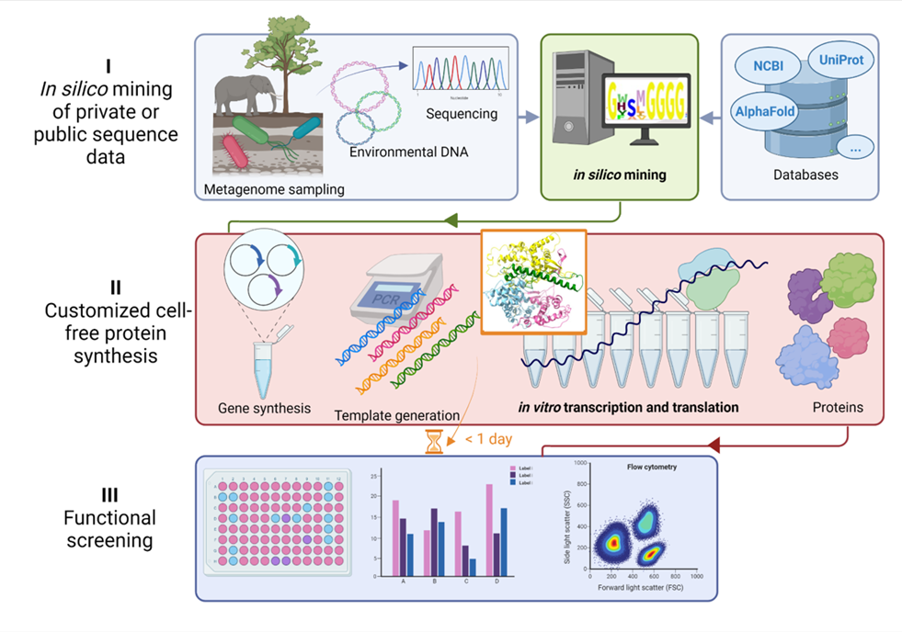
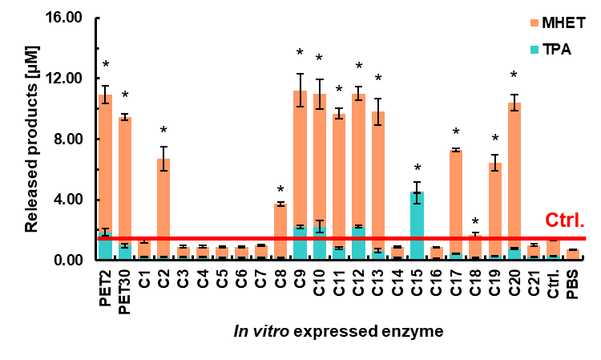
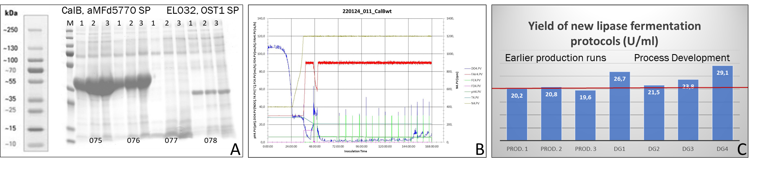
Task 4.1: Explanation of the work carried
Progress undertaken and outputs achieved
Small-scale enzyme production and characterization
  678x enzymes produced in soluble form:
    Hosts: 16x E. coli strains, Bacillus sp., C. glutamicum, P. pastoris, …
    Vectors (28x): pET-45b(+), pET-46, Ek/LIC46, p15TV-L, pCC1FOS, pCC2FOS, pET21a, pET22b, …
    Cult. media: LB, TB, SOC, Lindstrom AI, autoinduction ZYM, …
    Cult. volume: 0.1-5 L; Protein yield: 0.1-100 mg/L
  Development of an in vitro expression system:
    High-thoughput, cell-free method.
    Validated at UHAM using CelA2 cellulase, CalB lipase, sfGFP, and PETases →
  Development of P. pastoris and C. glutamicum expression systems:
    Integration plasmids for faster cloning, secretion signal/pro-peptide library, fermentation optimization with improved plasmids, and new promoters.
    Validated using CalB lipase and EUCODIS lipase 32:

Slide 69
Task 4.2: Smart design systems to obtain enzymes with inherent problems of expression (M3 – M30)
Objective
  To implement a system that, being smart by design, allows the production of a collection of ca. 10 biomimetic proteolytic systems.
Progress undertaken and outputs achieved
  Two strategies were employed to develop a novel class of artificial proteolytic enzymes that can be produced in large quantities:
    Production of artificial proteases via organo-catalysts
    Production of artificial proteases via rational engineering

Slide 70
Task 4.2: Explanation of the work carried
Progress undertaken and outputs achieved
Production of artificial proteases via organo-catalysts:
  Turn an esterase into a papain-like protease via synthetic catalytic suicide inhibitor possessing a chemo-catalytic activity.
  Turn an esterase into an oxidoreductase to degrade dye liquid (Schoeller).
Production of artificial proteases via rational engineering:
  Adding Cys-Hys catalytic dyads to transform an esterase into a PluriZyme (esterase + protease).
  Search for alternative protein architectures to introduce new catalytic sites.

Slide 71
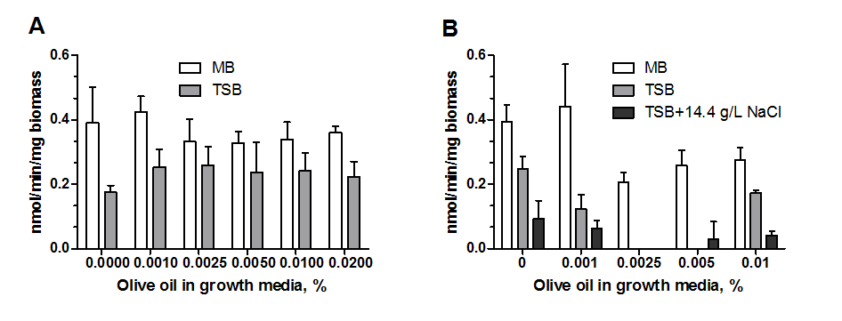
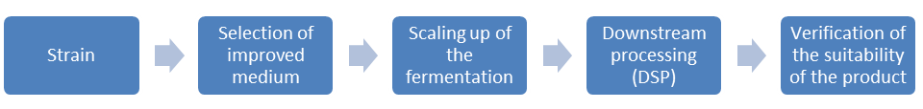
Task 4.3: Production of enzymes from their natural hosts M (M2 – M30)
Objective
  To obtain a collection of ca. 10 enzymes from native hosts that will be obtained by fermentation using non-conventional cultivation conditions.
Progress undertaken and outputs achieved
  Fermentation optimization protocols were implemented for cultivating new microbes and producing enzymatic materials:
  Native enzymatic materials (protein extracts) of 51 isolates were produced:
    12x lipase-esterases
    8x PET hydrolases
    29x glycoside hydrolases (25x hyaluronidases)
    2x proteases

Slide 72
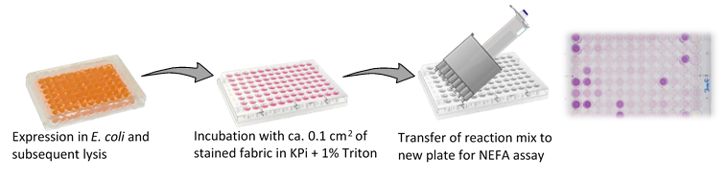
Task 4.4: Enzyme characterisation for selecting those with manufacturers’ specifications (M2 – M36)
Objective
  To proceed with the activity assessments of all enzymatic materials successfully produced, and generate their meta-data.
Progress undertaken and outputs achieved
  Evaluation of the best candidates under the conditions and requirements requested by manufacturers and also towards the real-life substrates:
    44x enzymes relevant for cosmetic applications. Also bacterial and archaeal isolates.
    591x enzymes relevant for detergent and textile applications.
    43x enzymes relevant for textile applications.
  Furthermore:
    11x crystal structures
    1st archaeal PETase
    Hydrolases on synthetic and bio-based polymers

Slide 73
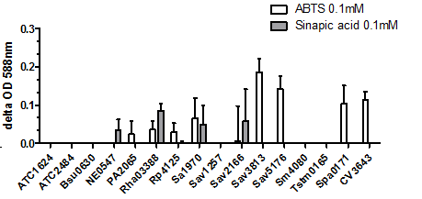
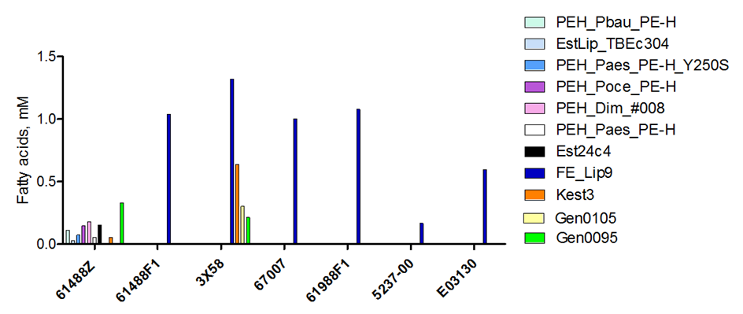
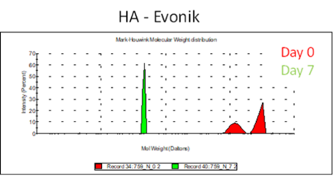
Task 4.4: Explanation of the work carried
Progress undertaken and outputs achieved
Enzyme characterization for selecting those with manufacturers’ specifications:
    Standardized stained swatches (Henkel).
    Residual spinning oils (fatty acid esters/amides/ethoxylates, mineral oil, paraffin, silicone) of synthetic fabrics (Schoeller).
    Removal of real-life dye BEMAPLEX Black D-HF, and the degradation of PET fabrics for evaluating their recycling (Schoeller).
    Degradation of hyaluronic acid products Hyacare and Hyacare50 (Evonik).
Figure 4.21. Best selected enzymes capable of Schoeller dye liquid discoloration.
Figure 4.19. Enzymatic preparations capable of removing spinning oils from raw Schoeller fabrics.
Figure 4.17. Enzymatic preparations capable of degrading stained swatches. Tests were performed as detailed in D3.2 using washing buffer (B).
Figure 4.16. Cells of Stutzerimonas stutzeri are capable of degrading Hyacare from Evonik into small size products after 7 days of biotransformation.

Slide 74
Task 4.5: Decision-making strategy for selecting lead enzyme candidates (M6 – M36)
Objective
  Based on multiple criteria, we will define the best enzymes to focus on.
Progress undertaken and outputs achieved
  368x enzymatic materials (native enzymes, mutants, immobilized preparation, biomimetic, protein extracts, etc.) have been selected as candidates having characteristics of interest for the three applications relevant for the FuturEnzyme project: detergent, textiles and cosmetics.
  Until M18 a set of 27 enzyme candidates were selected as priority candidates for WP5-WP7 →
ID | Enzyme¹ | Partner | Priority | SP² | Homology (%)³ | Application
1 | Kest3 (lipase) | Bangor | No | No | 33.87 | Detergent
2 | FE_Lip9 (lipase) | CSIC | Yes | Yes | 99.45 | Detergent, textile
3 | FE_ID9 (lipase) | CSIC | Yes | No | 100 | Detergent
4 | FE_polur1 (lipase) | CSIC | Yes | No | 97.3 | Detergent
5 | EstLip_Dim_#008 (lipase) | UDUS | Yes | No | 100 | Detergent
6 | EstLip_Paes_TB035 (lipase) | UDUS | Yes | Yes | 41.98 | Detergent
7 | EstLip_PtEst1 (lipase) | UDUS | Yes | No | 58.63 | Detergent
8 | EstLip_TBEc304 (lipase) | UDUS | No | No | 62.54 | Detergent
9 | PEH_Paes_PE-H_Y250S (PETase) | UDUS | Yes | Yes | 62.88 | Detergent, textile
10 | PEH_Pbau_PE-H (Lipase, PETase) | UDUS | No | Yes | 61.70 | Detergent, textile
11 | PEH_Pform_PE-H (Lipase, PETase) | UDUS | No | Yes | 69.08 | Textile
12 | PEH_Poce_PE-H (Lipase, PETase) | UDUS | No | Yes | 62.5 | Detergent, textile
13 | GEN0105 (Lipase, PETase) | Bangor | No | No | 61.69 | Detergent
14 | GEN0095 (cellulase) | Bangor | No | No | 52.5 | Textile
15 | VD_PL9 (hyaluronidase) | CNR | Yes | Yes | 88.89 | Cosmetic
16 | VD_PL22 (hyaluronidase) | CNR | No | No | 69.23 | Cosmetic
17 | VA_PL9 (hyaluronidase) | CNR | No | Yes | 32.38 | Cosmetic
18 | Hyal_HRDSV_2334 (hyaluronidase) | CNR | No | No | 100 | Cosmetic
19 | V. diabolicus V4 (hyaluronidase) | CNR | Yes | Yes | - | Cosmetic
20 | V. alginolyticus #23 (hyaluronidase) | CNR | Yes | Yes | - | Cosmetic
21 | FE_EH37 (esterase) | CSIC | No | No | 49.09 | Predictive tools
22 | FE_Lip5 (lipase) | CSIC | No | No | 43.52 | Detergent
23 | TR₂E₂ (PluriZyme) | CSIC | No | No | 66.74 | All
24 | EH_{1AB1C} (PluriZyme) | CSIC | No | No | 64.19 | All
25 | X11_mut1 (PluriZyme) | CSIC | No | No | 64.78 | All
26 | I8AMQ8 (Peroxidase) | Bangor | Yes | No | <50% | Textile
27 | Sav1970 (laccase) | Bangor | Yes | No | <50% | Textile
¹Nagoya protocol: information available and provided by partners. ²SP, Signal Peptide. ³Homology against patent database.

Slide 75
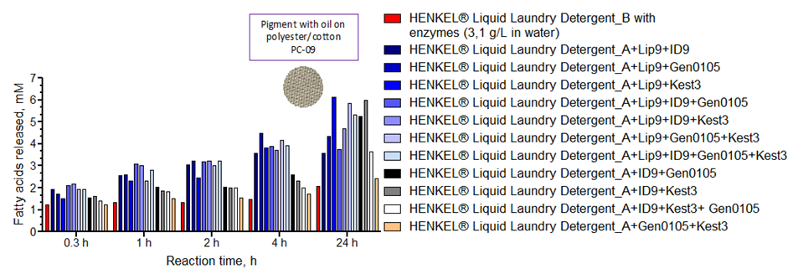
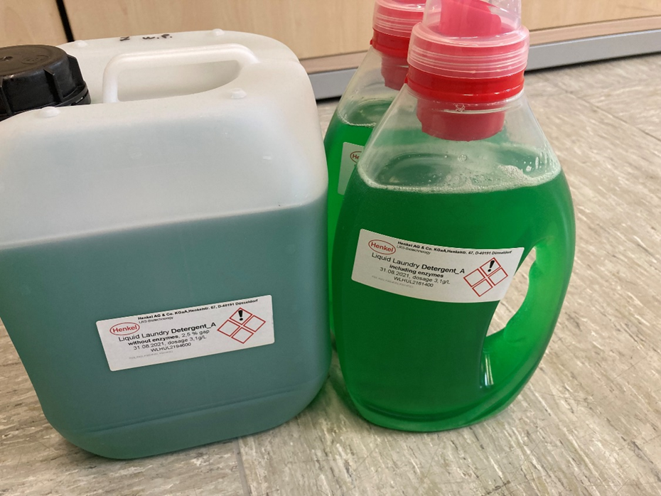
Task 4.6: Design of multi-enzyme blends to process complex ingredient mixtures (M12 – M40)
Objective
  To design multi-enzyme blends for formulating detergents and textiles, and a pre-selection of the three best performing and stable blends will be made.
Progress undertaken and outputs achieved
  10x enzymes have been selected for the production of cocktails to be used as additive in the Henkel liquid detergent
    Successfull tests with FE_Lip9, FE_ID9, Kest3 and GEN0105
  2x enzymes have been selected for the production of cocktails to be used for the degradation of spinning oils from Schoeller fabrics
  7x enzymes have been selected for the end-of-life fabric recycling of Schoeller PET-based fabrics
  2x enzymes have been selected for the production of cocktails to be used for the degradation of Schoeller dye
2.4-fold ↑

Slide 76
WP4 – Deliverables and milestones
• QR barcoding system (D4.1)
• The FuturEnzyme Portfolio of 1,000 enzyme (recombinant/native/biomimetic) material (D4.2)
• Cell-free expression/reported system (D4.3)
• The metadata on expression yield, activity and stability (D4.6)
• At least 180 enzymes (recombinant, native, biomimetic) with attractive properties (D4.7)
• Set of high-performing multi-enzyme blends (D4.8)
• First set of 250 enzymes expressed at mg scale (MS12)
• First set of benchmark enzyme materials available (MS13)
• At least 9 enzyme crystal structures (D4.5)
• Characteristics, first 180
enzymes (WP2-top ones) (MS14)
• Biomimetic protease production system (D4.4)
Originally due M16, but postponed to M30
• Characteristics, first 3 multienzyme
blends (MS15)
M1
M6
M12
M18
M24
M30
M36
M42
M48
Achieved in RP1
For next RPs
Deliverable
Milestone

Slide 77
WP4 - Expected and achieved outputs
Key bullet points
Key bullet points (non-scientific)
  A total of 46.93 P/M (out of 173 total, a 27.13%) have been invested, which were effective to achieve the objectives.
  The work plan is proceeding as planned (see Table 4.1)
        Table 4.1. Brief summary of clear and measurable details and achievements in WP4 (as in the GA)
Name of activity | Achieved | Achievement (%) | Status
1 QR barcoding system (D4.1) | Yes | 100% | Completed
1,000 enzymatic materials (D4.2) | Partially | 68% | Open
1 Cell-free expression/ reported system (D4.3) | Yes | 100% | Completed
1 Biomimetic protease production system (D4.4) | Partially | 50% | Open
9 Enzyme crystal structures (D4.5) | Yes | 133% | Completed
Metadata, expression yield, activity and stability (D4.6) | Partially | 10% | Open
180 priority enzymes (D4.7) | Yes | 204% | Completed
Set of high-performing multi-enzyme blends (D4.8) | Partially | 10% | Open
Deliverables (4, at M18) | Yes | 100% | Completed
Milestones (2, at M18) | Yes | 100% | Completed

Slide 78
WP4 - Expected and achieved outputs
Key bullet points
Key bullet points (scientific):
  A series of protocols, many extended to real-life substrates, have been used to characterize and identify enzymes with high potential in the three target sectors.
  17x bacterial and eukaryotic expression hosts and 27x vectors are successfully in use so far.
  Contributions and integration were highly efficient and according to the work plan: CSIC has contributed to with 344 enzymes, UDUS with 62, BANGOR with 122, UHAM with 109, IST-ID, CNR and Bio_Ch with optimized enzyme production systems from native hosts. FHMW, CSIC, and EUCODIS with biomimetic and artificial enzymes production systems. EUCODIS with new methods and protocols for P. pastoris and C. glutamicum.
  A rapid in vitro expression platform has been validated and is available. The novel RNA-Polymerase EM1 identified and used to establish a rapid in vitro expression platform improves the applicability of the system in terms of cost and efficiency.
  Development of suitable sample collection and fermentation optimization media and conditions to best finding and cultivating appropriate isolates hosting target enzymes and to increase production yields.
Notes:
BSC?

Slide 79
WP4 - Expected and achieved outputs
Key bullet points
Key bullet points (scientific, cont.):
  A total of 678 out of 1,612 enzymes have been successfully produced and characterized; they are broadly diverse and distantly related to known homologues in many cases.
  Pre-characterized enzymes: 536x lipases/esterases (42x polyester hydrolases), 109x GHs (41x hyaluronidases), 6x amidases, 3x PluriZymes, 3x proteases/peptidases, 21x oxidoreductases (laccases and peroxidases).
  Fully characterized enzymes: 12x lipases/esterases, 8x PET hydrolases, 29x GHs (25x hyaluronidase), and 2x protease producing bacterial strains.
  Conditions to the growth of yet-to-be cultivated strains are available.
  A series of organo-catalytic inhibitors and protein scaffolds have been developed for the production of artificial biomimetics with proteolytic and oxidoreductase activities and artificial proteases.
  A set of 368x selected candidates with characteristics of interest for the three target applications by adaption of assays allowing to measure fatty acid and hyaluronic acid product release in high-throughput format, with 27x being selected as priority; 11x crystal structures of 5 enzymes have been solved.
  First experiment demonstrated that combination of best enzymes allowed a better implementation of more efficient liquid detergents.

Slide 80
WP4 – Future actions
Future actions (six months ahead):
  Complete the experimental characterization of all enzymes identified, with especial emphasis of those with interesting properties, as well as to approach the production and characterization of new ones. Special emphasis will be given to generate metadata with which to feed WP2.
  Complete the synthetic and engineering work and to test the molecules produced with target enzymes.
  Perform small to medium-scale production of priority enzymes, so that their immobilization and the preparation and testing of multi-enzyme blends for the target applications can be approached.
  Test selected enzymes in small-scale reactors using complex real substrates, including stains in fabrics and viscous hyaluronic acid (HA) solutions.

Slide 81
WP4 – Deviations
Deviations
  No deviations found in the activities planned in the GA, and no mitigation actions are required.
  That said, HR-related issues reported in D4.4 (M16), which prompted us to apply for a postponement of the submission of the final version of the deliverable (M30). Those problems are solved and progresses are in line with the DoA (the Project Officer was informed and postponement approved, 3 October 2022).

Slide 82
FuturEnzyme
Technologies of the FUTURe for low-cost ENZYMEs for environment-friendly products
WP5 – Enhancing enzymes through innovative engineering
FuturEnzyme: First Reporting Period
Start date: 1 June 2021 - End date: 31 May 2025
Proposal number: 101000327 - Consortium: 16 partners
Requested EU Contribution: 5,995,035.13 €
Project funded by the European Union’s Horizon 2020
Research and Innovation Programme under grant agreement No [101000327]

Slide 83



WP5 - Enhancing enzymes through innovative engineering
OBJECTIVE: To generate enhanced enzyme variants with real potential for manufacturing the target products.
Task 5.4 Empowering enzymes by immobilization-guided supramolecular engineering
Task 5.1 Disruptive engineering computational tools
2005
2012
Lipase engineering for detergent and textile applications
Engineering FE_Lip5 by lid domain remodeling
Supramolecular engineering using artificial chaperones
Expanding the range of supports
Improving immobilization-guided engineering for reduced production costs
SELECTED ENZYMES
(WP4)
Task 5.2 PluriZymes with multipurpose activities
Task 5.3 Other advanced and classical methods
In-One Protease-Esterase, Transaminase-Esterase and Xylanase-Esterase PluriZymes
Asite design
Fragaceatoxin
Lipase engineering
PETase engineering
Tasks 5.1-5.3
Tasks 5.4
M1
M6
M12
M18
M24
M30
M36
M42
M48

Slide 84



WP5 - Partners involved
WP5 lead
University of Applied Sciences and Arts Northwestern Switzerland
WP5 contributing partners
CSIC, Agencia Estatal Consejo Superior de Investigaciones Científicas
BANGOR, Bangor University
BSC, Barcelona Supercomputing Center
Eucodis
UDUS, Heinrich-Heine Universitaet Duesseldorf
INOFEA
UHAM, Universitaet Hamburg

Slide 85
WP5 – Interactions
Machine learning bio-prospecting
Fermentation, DSP, Formulation Development
WP2
WP6
Larger scale and formulated enzymes
Feedback
Activity-based bio-prospecting
WP3
WP5
WP7
Enzyme engineering
Industrial Application Tests
WP4
Enzymes
Enzymes for small scale application tests

Slide 86
Task 5.1-5.4: Explanation of the work carried
Progress undertaken and outputs achieved
Objective
  To generate a collection of engineered enzymes performing better than benchmark enzymes using protein engineering tools.
Which are the target enzymes?
  A sub-set of those selected as priority in WP4, on the basis of their high performance toward real products and specifications
    FE_Lip9, Gen0105, Kest3 and PEH_Paes_PE-H hydrolases: as additives for detergents
    FE_Lip9, PEH_Paes_PE-H and PET46 poly-ester hydrolases: for PES-textile recycling
    FE_Lip9, PEH_Paes_PE-H and Gen0095 hydrolases: for spinning oil clean-up in textile products
  A subset of those selected for stablishing the basis of novel engineering tools for future testing priority candidates
    EH_{1AB1} PluriZyme
    TR2E2 transaminase
    X11_mut1 xylanase
    Fragaceatoxin C (FraC) from Actinia fragacea
    De novo homodimeric TIM barrel-ferredoxin (PDB: 6WXO)

Slide 87
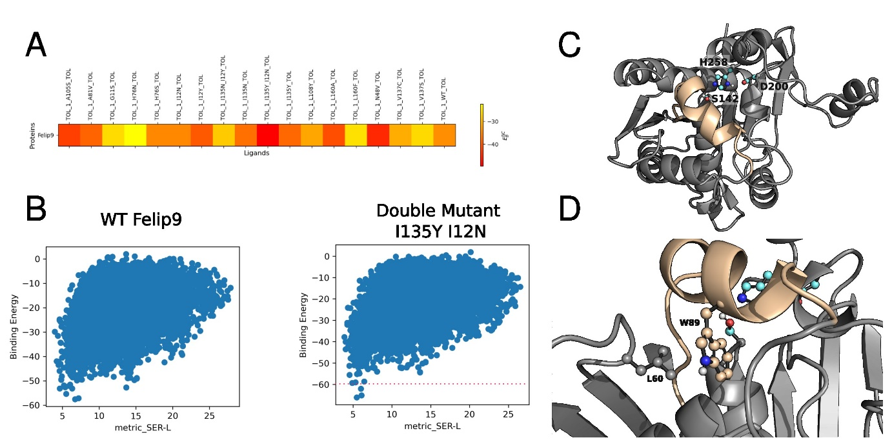
Task 5.1: Explanation of the work carried
Progress undertaken and outputs achieved
Objective: engineered enzymes using disruptive protein engineering tools
Progress undertaken and outputs achieved
  Lipase FE_Lip9 engineering undertaken in silico to yield 18 different mutants (PELE optimization) – experimental validation in progress
  Lipase FE_Lip5 lid remodeling: several good candidates displaying in silico a larger lid opening were identified and confirmed experimentally.
Lid domain FE_Lip5 (FRGTEITQIKDWLTDA)
↓
Substituted by the lid domain of Rhizopus oryzae lipase
(FRGTNSFRSAITDIVF)
↓
The engineered variant FE_Lip5lid degrade palm oil
(AB) PELE results for FE_Lip9 using triolein as substrates
(C-D) AlphaFold 3D model structure of FE_Lip5, highlighting the lid domain and close residues.

Slide 88

Task 5.2: Explanation of the work carried
Progress undertaken and outputs achieved
Objective
  Engineered enzymes adding additional active sites: design of PluriZymes.
Progress undertaken and outputs achieved
  Some of the enzymes were engineered following the PluriZyme approach.
  The general and now-established strategy is based on the following in silico and in vitro sequence:
  Several proteins with two active sites, PluriZymes, have been designed and the corresponding workflow rationalized (Asite Design).
Non catalytic binding site search (PELE)
Site-directed mutagenesis
Local exploration of substrate binding
Protein expression and activity testing

Slide 89
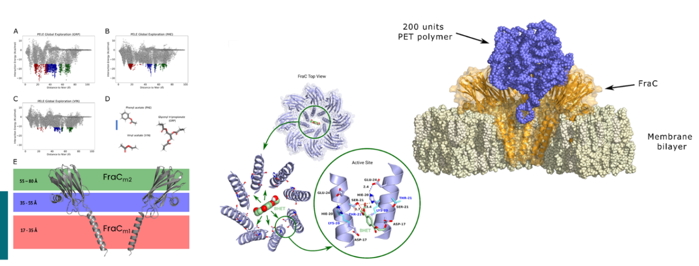
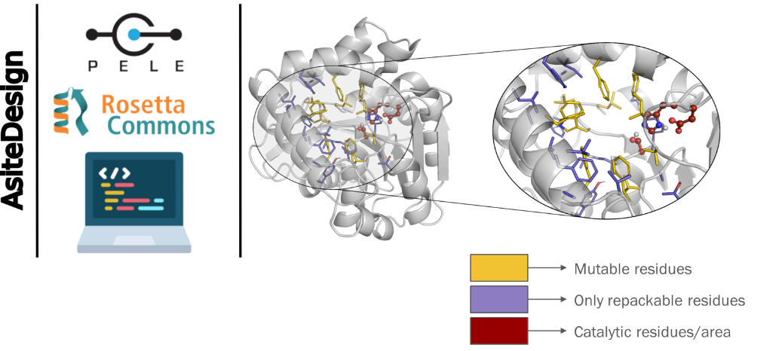
Task 5.2: Explanation of the work carried
Progress undertaken and outputs achieved
PluriZymes produced thus far:
  In-One Protease-Esterase PluriZyme
  In-One Transaminase-Esterase PluriZyme
  In-One Xylanase-Esterase PluriZyme
  Fragaceatoxin C engineering
  Catalytic triad supporting ester hydrolysis to a de novo TIM barrel protein for the introduction of an organocatalytic inhibitor produced in WP4.
  AsiteDesign: A heuristic algorithm to design and redesign active sites.
FraC protein. The protein is assembled as pore-based biocatalytic nanoreactor capable of breaking down nano-polyester textiles
AsiteDesign. Schematic representation of the AsiteDesign algorithm.

Slide 90
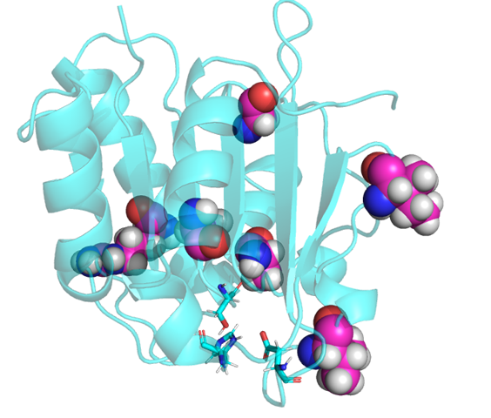
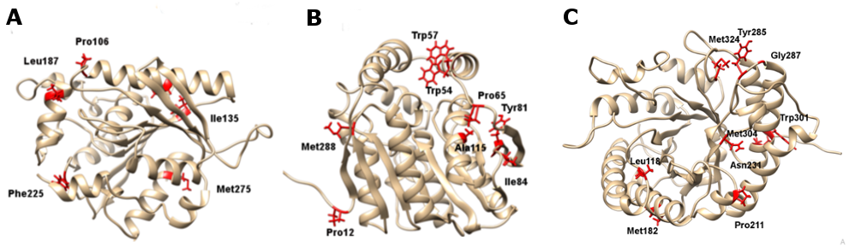
Task 5.3: Explanation of the work carried
Progress undertaken and outputs achieved
Objective
  Engineered enzymes using synthetically based mutation and classical semi-rational engineering methods.
Progress undertaken and outputs achieved
  A set of 4 lipases were engineered through hotspot wizard and FireProt tools
3D structure of FE_Lip9 representing the main hotspots. The position of Val161 is highlighted. The mutant Val161Ser is being capable of degrading pigment with oil on Polyester/Cotton - 90 cm width (PC-09) 2.4-fold more efficient than the benchmark product at a concentration as low as 0.07% w/v.
Selection of mutants in Kest3, Gen0105 and Gen0095. 3D structure of Kest3 (A) and Gen0105 (B) with mutated residues (FireProt) highlighted in red. (C) 3D structure of Gen0095. The mutated residues (Energy optimization, FireProt) are highlighted in red. Experimental validation in progress.

Slide 91



Task 5.3: Explanation of the work carried
Progress undertaken and outputs achieved
Objective
  Engineered enzymes using synthetically based mutation and classical semi-rational engineering methods.
Progress undertaken and outputs achieved
  A set of 2 PET hydrolases were engineered through docking and literature-informed mutagenesis
PEH_Paes_PE-H engineering. A single mutation increase by 2.5x the capacity to degrade a PET-based sample textile 4-b 3X58 (VORB, 100% PES 100g/m²) pretreated by alkaline boiling, and 4.4x the degradation of lipstick stain.
PET46 uses the lid domain to effectively degrade MHET, BHET and 3PET. The A46V mutant was 3.17-fold better than the WT enzyme to degrade 3PET.

Slide 92

Task 5.4: Explanation of the work carried
Progress undertaken and outputs achieved
Objective
  To generate a collection of immobilized enzyme preparations in silica nanoparticles, where single enzymes or multi-enzyme systems are shielded by a protective layer of controlled thickness and composition.
Progress undertaken and outputs achieved
  Supramolecular engineering using artificial chaperones
  Expanding the approach of supramolecular engineering to a larger set of supports
  Anchoring of enzymes through their His-tag on silica particles and shielding
Supramolecularly engineering of FE_Lip9 using a novel cyclodextrin building block at 50°C resulting in a markedly enhanced thermal stabilization.
Supramolecularly engineering on polymeric microparticles, starting material (A) and modified polymeric particles (B) imaged by scanning electron microscopy.

Slide 93
WP5 - Expected and achieved outputs
Key bullet points (non-scientific)
  A total of 28.6 P/M (out of 96 total, a 29.79%) at M18.
  The work plan is proceeding as planned (Table 5.1)
        Table 5.1. Brief summary of clear and measurable details and achievements in WP5 (as in the GA)
Name of activity | Achieved¹ | Achievement (%) | Status
18 Enzymes nominated for engineering (D5.1) | Yes | 122% | Open
18 Mutants generated by genetic engineering (D5.2) | Partially | 40% | Open
4 PluriZymes with single activities (D5.3) | Partially | 75% | Open
3 Multi-purpose PluriZymes (D5.4) | Yes | 100% | Open
18 Improved enzymes by supramolecular engineering (D5.5) | Partially | 20% | Open
Datasets of engineered variants (D5.6) | Partially | 40% | Open
Deliverables (4, at M18) | Yes | 100% | Completed
Milestones (2, at M18) | Yes | 100% | Completed

Slide 94
WP5 - Expected and achieved outputs
Key bullet points (scientific)
  A series of engineering strategies, including those based on the PluriZyme, lid domain swapping, hotspot wizard and FireProt tools.
  A series of mutants best performing as additive in liquid detergents and polyester fabrics recycling.
  Gained knowledge on enzymes (12 in total) and effect of mutations (32 in total).
  A new heuristic algorithm to design and redesign active sites in proteins or enzymes (AsiteDesign).
  Engineered de novo protein structures.
  Supramolecular building blocks for further stabilization of immobilized lipases.
  Immobilization guided engineering optimized, lower productions costs (for targeted applications)
  Engineered variants with performances from about 2 to 7-5-fold higher than benchmark were achieved.

Slide 95
WP5 – Deliverables and milestones
• The shortlist of at least 18 enzymes nominated for engineering (D5.1)
Genetic engineering: first round completed (MS16)
Set of 18 improved enzymes by supramolecular engineering (D5.6)
Supramolecular engineering: first round completed (MS18)
Set of 18 improved enzymes by supramolecular engineering (D5.5)
First set of PluriZymes (MS18)
Set of 3 multi-purpose PluriZymes (D5.4)
Set of 4 PluriZymes with single activities (D5.3)
Set of 18 mutants generated by genetic engineering (D5.2)
M1
M6
M12
M18
M24
M30
M36
M42
M48
Achieved in RP1
For next RPs
Deliverable
Milestone

Slide 96
WP5 – Future actions
Future actions (six months ahead)
  To experimental validate the effect of all mutations already identified as interesting candidates, as well as to continue engineering a new set of enzyme candidates from the ones listed in D5.1, and others yet to be identified.
  To apply the AsiteDesign heuristic algorithm and PluriZyme strategy to lipases retrieved in FuturEnzyme to develop multi-functional PluriZymes of interest in the detergent and textile sectors.
  To perform, at large scale, the supramolecular engineering, using different approaches, of priority targets, particularly in those applications where immobilization is an alternative, namely, immobilization of oxidoreductase for dye removal during fabrics processing and spinning oil removal.

Slide 97
WP5 – Deviations
Deviations
  No deviations found in the activities planned in the GA, and no mitigation actions are required.

Slide 98
FuturEnzyme
Technologies of the FUTURe for low-cost ENZYMEs for environment-friendly products
WP6 – Development and supply of best enzyme prototypes
FuturEnzyme: First Reporting Period
Start date: 1 June 2021 - End date: 31 May 2025
Proposal number: 101000327 - Consortium: 16 partners
Requested EU Contribution: 5,995,035.13 €
Project funded by the European Union’s Horizon 2020
Research and Innovation Programme under grant agreement No [101000327]

Slide 99
WP6 – Development and supply of best enzyme prototypes
OBJECTIVE
  To develop and scale-up fermentation and DSP methods for the production, adapted to requirements of WP7 partners, formulation and quality assessments of best selected enzyme candidates. WP6 will, together with WP7, evaluate the Performance of the candidates in application tests, their Stability during application and storage (technical feasibility), Producibility of the respective enzyme at cost level acceptable for application (economic feasibility), as well as the Environmental feasibility.
  TASKS
    Fermentation and DSP of best 18 project enzymes (M16 – M42) (TASK 6.1)
    Upscaling (non-GMP) fermentation and DSP of 9 best enzymes (M20 – M48) (TASK 6.2)
    Development of optimized formulations of 9 lead enzyme candidates (M20 – M48) (TASK 6.3)
    Safety, risk and environmental impact assessments of enzyme supply (M20 – M48) (TASK 6.4)
M1
M6
M12
M18
M24
M30
M36
M42
M48
Task 6.2
Task 6.3
Task 6.4
Task 6.1

Slide 100
WP6 – Development and supply of best enzyme prototypes
WORK DONE/STARTED
  Task 6.1: Fermentation and DSP of best 18 project enzymes (M16 – M42):
    Selection of first round of enzyme candidates with WP4, WP5 and WP7 partners
    Sequences transferred to WP6; gene optimization started for secreted expression
    Strains transferred for expression from native sources
    Fermentation and isolation of two lead candidates in E. coli
  Task 6.2: Upscaling (non-GMP) fermentation and DSP of 9 best enzymes (M20 – M48):
    Not yet started
  Task 6.3: Development of optimized formulations of 9 lead enzyme candidates (M20 – M48):
    Not yet started
  Task 6.4: Safety, risk and environmental impact assessments of enzyme supply (M20 – M48):
    Not yet started

Slide 101
WP6 - Partners involved
WP6 lead
EUC, Eucodis Bioscience GMBH
WP6 contributing partners
CSIC, Agencia Estatal Consejo Superior de Investigaciones Científicas
ITB, Consorzio Italbiotec
IST-ID, The Association of Instituto Superior Técnico For Research and Development
Bio_Ch, Bio-Chem Solutions SRL
CLIB, Cluster Industrielle Biotechnologie e.V.
INOFEA, Inofea AG

Slide 102
WP6 - Interactions
Machine learning bio-prospecting
Fermentation, DSP, Formulation Development
WP2
WP6
Larger scale and formulated enzymes
Feedback
Activity-based bio-prospecting
WP3
WP5
WP7
Enzyme engineering
Industrial Application Tests
WP4
Enzymes
Enzymes for small scale application tests

Slide 103
Task 6.1: How to achieve objectives, and work done
Fermentation and DSP of best 18 project enzymes (M16 – M42)
Objective:
  To establish scalable fermentation and DSP methods for the priority enzymes selected in WP4 and WP5 and provide samples for applications tests of the WP7 partners
  To optimize media (e. g. carbon and nitrogen sources and trace elements), growth conditions and identify the best conditions for oxygen, shear stress, and temperature to obtain the best production performance under minimal energy consumption and waste generation
Progress undertaken and outputs achieved
  First two lead candidates (FE_Lip9 and FE_ID9) expressed in gram scale by CSIC
  Gene optimization for secreted, recombinant expression started at EUCODIS
  Native strains transferred Bio_Ch for fermentation development

Slide 104

Task 6.1: How to achieve objectives, and work done
Expression and Purification of the first two enzyme candidates in E. coli
  CSIC: Isolation of FE_Lip9 and FE_ID9 in gram scale, purified material transferred to partners FHNW and INOFEA
    E. coli fermentation in 12 L scale in Biostat C Plus Fermenter, harvest of biomass
    DSP from biomass using French Press for homogenization and metal affinity chromatography to obtain high purity enzyme samples
    Analysis of yield and purity by SDS-PAGE
Name | FE_Lip9 | FE_ID9
Total cell pellet, grams | 10.2 g | 24.7 g
Volume, after French Press | 200 | 180
Total protein (mg/mL), after French Press | 23.31 mg/mL | 63.26 mg/mL
Total protein, after His-tag purification | 1051 mg | 2009 mg

Slide 105
Task 6.2: How to achieve objectives, and work done
Upscaling (non-GMP) fermentation and DSP of 9 best enzymes (M20 – M48)
Objective
  To evaluate, improve and optimize methods for expression, DSP and, if required, the immobilization of the narrowed-down priority candidates from Task 6.1.
  To generate and supply larger scale (multi-gram to kg quantities) of the obtained enzyme materials (e. g. single soluble enzymes or immobilized variant thereof, multi-enzyme soluble blends or multi-enzyme nano-formulations, if applicable) to WP7 partners for larger application trials after activity validation
Progress undertaken and outputs achieved
  This task has not yet started, progress and results will be presented in the next report.

Slide 106
Task 6.3: How to achieve objectives, and work done
Development of optimized formulations of 9 lead enzyme candidates (M20 – M48)
Objective
  To develop and optimize application-specific formulation of the lead enzymes and their optimization.
  To supply samples to WP7 partners and improve the formulations depending on feedback from the WP7 application tests (Task 7.1-7.3) in an iterative procedure
Progress undertaken and outputs achieved
  This task has not yet started, progress and results will be presented in the next report.

Slide 107
Task 6.4: How to achieve objectives, and work done
Safety, risk and environmental impact assessments of enzyme supply (M20 – M48)
Objective
  To assess the safety, risks and environmental impact of the lead enzymes
  To evaluate the economic feasibility and sustainability of the new enzymes, their production and their impact on various aspects based on data, such as raw material, energy and water consumption and the amount and nature of the waste produced, for both the production (fermentation and DSP) to obtain the enzymes and the process pipeline for supply of the final formulations.
Progress undertaken and outputs achieved
  This task has not yet started, progress and results will be presented in the next report.

Slide 108
WP6 – Deliverables and milestones
First set of best enzymes at gram scale (MS19)
Best 18 Pre-Lead Enzyme Materials in gram scale (D6.1)
Report on fermentation, optimization and verification for 9 Lead Enzyme Material (D6.4)
5 Deliverables (M32-M48)
3 Milestones (M20, M22, M32)
First set of lead enzymes at multi-gram scale (MS20)
Report on fermentation, DSP and activity verification for 18 Pre-Lead enzymes(D6.2)
Safety, risk, and environmental
evaluation sheet for 9 enzymes with premarket value, available (D6.5)
Best 9 Lead Enzyme Materials obtained at multi-gram/kg scale for real-life test (D6.3)
M1
M6
M12
M18
M24
M30
M36
M42
M48
Achieved in RP 1
For next RPs
LCA report for supplying the
first set of enzymes (MS21)
Deliverable
Milestone

Slide 109
WP6 - Expected and achieved outputs
Key bullet points (scientific/non-scientific)
  A total of 4.95 P/M (out of 97.9 total, a 5.06%) have been invested, being effective to achieve the objectives at M18.
  WP6 just started with the selection of the first set of enzyme candidates with WP4, WP5 and WP7 partners, also in respect of Nagoya protocol.
  Two lipase candidates expressed and purified from E. coli in gram scale (MS19).
  Sequences submitted to WP6 partners, in silico genetic optimization and gene synthesis started.
  Regular meeting schedule with WP7 partners established to organize the enzyme selection, sample supply and feedback loop.
Table 6.1. Brief summary of clear and measurable details and achievements in WP6 (as in the GA).
Name of activity | Achieved | Achievement (%) | Status
Selection of enzyme candidates with WP4/5/7 partners | Partially | 50% | Open
Enzyme materials and report obtained at gram scale for real-life tests (D6.1, D6.2) | Partially | 5% | Open
Materials and report of best enzymes obtained at multi-gram/kg scale for real-life tests (D6.3, D6.4) | Not started | 0% | Open
Safety, risk, and environmental evaluation, market evaluation (D6.5) | Not started | 0% | Open
Deliverables (5 in total, at M32-M48) | Not started | 0% | Open
Milestones (3 in total, MS19-MS21, at M20, M22, M32) | Partially | 10% | Open

Slide 110
WP6 – Future actions
Future actions (six months ahead)
  Secreted expression of selected enzymes candidates in Pichia pastoris, Bacillus subtilis and/or Corynebacterium glutamicum will be performed
  Expression of first selected enzyme candidates in native hosts will be performed
  First samples of enzymes prepared for industrial application tests and/or immobilization tests
  Expected results for next months:
    Secreted expression of lead enzyme candidates established
    Stability tests started
    Samples supplied to WP7 partners, feedback on performance in application tests

Slide 111
WP6 – Deviations
Deviations
  No deviations found in the activities planned in the GA, and no mitigation actions are required.
  Milestone MS20 slightly delayed (1-2 months) due to delay in selection of enzyme candidates.

Slide 112
FuturEnzyme
Technologies of the FUTURe for low-cost ENZYMEs for environment-friendly products
WP7 – Formulation and manufacturing of consumer products: sustainability and environmental assessments
FuturEnzyme: First Reporting Period
Start date: 1 June 2021 - End date: 31 May 2025
Proposal number: 101000327 - Consortium: 16 partners
Requested EU Contribution: 5,995,035.13 €
Project funded by the European Union’s Horizon 2020
Research and Innovation Programme under grant agreement No [101000327]

Slide 113
WP7 - Formulation and manufacturing of consumer products: sustainability and environmental assessments
OBJECTIVE
  Validation of enzyme performance and stability under industrially relevant conditions
  Upscaling of appropriately dimensioned trials for the application of enzymes to 3 project’s sectors (detergents, textiles, cosmetics)
  Life cycle assessment (LCA) of newly developed enzyme-containing processes / products in comparison to conventional benchmark processes / products
  TASKS
    Pre-industrial validations: formulation of real-life and solution-oriented detergents (M20 – M48) (TASK 7.1)
    Pre-industrial validations: formulation of real-life and solution-oriented textiles (M20 – M48) (TASK 7.2)
    Pre-industrial validations: formulation of real-life and solution-oriented cosmetics (M20 – M48) (TASK 7.3)
    LCA assessments: detergent, textile and cosmetic products (M1 - M48) (TASK 7.4)
M1
M6
M12
M18
M24
M30
M36
M42
M48
Task 7.1
Task 7.2
Task 7.3
Task 7.4

Slide 114
WP7 - Formulation and manufacturing of consumer products: sustainability and environmental assessments
WORK DONE
  Task 7.1-7.3: Pre-industrial validations: formulation of real-life and solution-oriented detergents, textiles, cosmetics:
    Completion, collection and sharing of inventory for detergent / textile / cosmetic benchmark
    Initial Industry meetings to define and exchange the experimental requirements between WP partners
    Set-up of an individual working scheme per project‘s sector for efficient collaboration between project partners
  Task 7.4: LCA assessments: detergent, textile and cosmetic products:
    Completion, collection and sharing of inventory for detergent / textile / cosmetic benchmark
    Definition of system boundaries for LCA
    Exchange of data for the LCA between industrial partners and ITB

Slide 115

WP7 - Partners involved
WP6 lead
CLIB, Cluster Industrielle Biotechnologie e.V.
WP6 contributing partners
CSIC, Agencia Estatal Consejo Superior de Investigaciones Científicas
Bio_Ch, Bio-Chem Solutions SRL
EVO, Evonik Operations GMBH
IST-ID, The Association of Instituto Superior Técnico For Research and Development
HENKEL, Henkel AG & Co KGaA
ITB, Consorzio Italbiotec
SCHOELLER, Schoeller Textil AG

Slide 116
WP7 - Interactions
Machine learning bio-prospecting
Fermentation, DSP, Formulation Development
WP2
WP6
Larger scale and formulated enzymes
Feedback
Activity-based bio-prospecting
WP3
WP5
WP7
Enzyme engineering
Industrial Application Tests
WP4
Enzymes
Enzymes for small scale application tests

Slide 117
Task 7.1-7.3: How to achieve objectives, and work done
Objective
  Establishment of reliable methods to measure enzyme performance under industrially relevant (real-life) conditions
  Validation of enzyme performance and stability under industrially relevant conditions
  Upscaling of appropriately dimensioned trials for the application of enzymes to 3 project’s sectors (detergents, textiles, cosmetics)
Progress undertaken and outputs achieved
  Specification on priority enzyme functionalities for different project’s sectors
    Detergents: Removing specific fatty oil stains and related fatty-oils, multi-functional PluriZymes supporting such activities
    Textiles: Removing residual spinning oils, supporting decolorization of dyes, degrading polyester for recycling of textiles, multi-functional PluriZymes supporting such activities
    Cosmetics: Degrading hyaluronic acid to products of defined size to be integrated into cosmetics
  Material transfer from Henkel, Evonik and Schoeller to academic partners: real-life products (benchmarks) and test substrates (stains, dye, textiles, hyaluronic acid, etc.)
  Decision on distribution of PRE-LEAD enzyme candidates among SME partners for establishment of fermentation (WP6)

Slide 118
Task 7.4: How to achieve objectives, and work done
Objective
  To evaluate the environmental impact of the new products compared to the initial products and the benchmark ones already on the market
Progress undertaken and outputs achieved
  LCA activities on three benchmark products (face cream cosmetic, liquid detergent, PES textile)
  LCA-Step 1: Goal and scope definition
  LCA-Step 2: Life cycle inventory
    Individual meetings with technology / product providers
    Patent and literature search

Slide 119
WP7 – Deliverables and milestones
First round of laundry tests completed (MS22)
First round of textile tests completed (MS23)
First tests for hydrolysis of hyaluronic acid (HAh) (MS24)
A leading liquid and a unit dose cap detergent product with new enzymes integrated (D7.2)
3-4 Enzymatically functionalized leading textiles in more than DIN A4 size (D7.3)
A leading cosmetic formulation with an enzyme-based HA-hydrolysis product integrated (D7.4)
First tests for producing HAh at gram scale (MS25)
First trials for incorporating HAh into cosmetics (MS26)
First report on product characteristics (MS27)
First LCA report for the 3 FuturEnzyme products (MS28)
LCA report of the 3 real-life products (D7.5)
Report on small/ medium validation trials of 18 best pre-selected enzymes (D7.1)
M1
M6
M12
M18
M24
M30
M36
M42
M48
Achieved in RP1
For next RPs
Deliverable
Milestone

Slide 120
WP7 - Expected and achieved outputs
Key bullet points
Key bullet points (non-scientific)
  A total of 5.86 P/M (out of 83 total, a 7%) have been invested, being effective to achieve the objectives at M18.
  Based on the information provided in Table 7.1 we consider that the work plan is proceeding as planned
        Table 7.1. Brief summary of clear and measurable details and achievements in WP7 (as in the GA)
Name of activity | Achieved | Achievement (%) | Status
Report on small/medium validation trials of 18 best pre-selected enzymes (D7.1) | Partially | 5% | Open
A leading liquid and a unit dose cap detergent product with new enzymes integrated (D7.2) | Partially | 10% | Open
3-4 enzymatically functionalized leading textiles in more than DIN A4 size (D7.3) | Partially | 10% | Open
A leading cosmetic with an enzyme-based HA-hydrolysis product integrated (D7.4) | Partially | 10% | Open
LCA report of the 3 real-life products (D7.5) | Partially | 20% | Open
Report on project results and lessons learned (D7.6) | Open | 0% | Open
8 Task group meetings | Partially | 50% | Open
Deliverables (0 at M18) | Open | 0% | Open

Slide 121
WP7 - Expected and achieved outputs
Key bullet points
Key bullet points (scientific)
  Specification of the required amount of enzyme (largest scale within the project) for performing industrial product trials
    Detergents: Full-scale washing tests require 0.2 – 1.0 g per enzyme
    Textiles: A4-sized fabric requires 200 mL of enzyme solution (enzymes in g-scale)
    Cosmetics: Integration of 1-100 g enzyme-treated hyaluronic acid into cosmetics requires enzyme at mg- to g-scale
  Excel database collecting the Life Cycle Inventory for the detergent benchmark to be used for the comparison with the innovative product.
  Exchange of data for the Life Cycle Assessment with industrial partners.

Slide 122
WP7 – Future actions
Future actions (six months ahead)
  Industry meeting #2 to inform industry partners on different bioprospecting activities of academic partners (January 23)
  Establishment of analytical methods on real-life substrates
  Validation of PRE-LEAD enzyme production by SME partners
  LCA for detergents: Step 3 “Impact Assessment” on environmental impacts
  LCA for cosmetics: Finalization of Step 1 “Goal and scope definition”
  LCA for textiles: Completion of Step 2 “Life Cycle Inventory”

Slide 123
WP7 – Deviations
Deviations
  No deviations found in the activities planned in the GA, and no mitigation actions are required.

Slide 124


Task 8.2: FuturEnzyme Website and strong on-line meeting platform
Effectiveness of the action:
Users 585
Average interaction time: 1 min 36 sec
Main country: Spain (88 users)
Acquisition of users: organic search (55.2%), direct search (30.1%)
Most visited section: Partners and Events
Period of the analysis: September 2022 to November 2022
Total number of users from July 2021 to September 2022:
28,216

Slide 125






Task 8.3: Dissemination and Communication: toolkit and public relations
Objective
  To develop a suite of dissemination, communication and PR toolkits to support the implementation of the Dissemination and Communication Strategy
Main outputs
  Visual identity guidelines and templates: include fonts and colours, templates for deliverables and power point presentations, FuturEnzyme’s original pictures, partners’ images used for the project, short movies and comics (the latter are ongoing).
LOGO
ORIGINAL IMAGES

Slide 126
Task 8.3: Dissemination and Communication: toolkit and public relations
Offline communication tools
  Brochures: 4 brochures for different target audiences (delivered at M11). The ones dedicated to consumers were translated to Italian, Spanish and German (delivered at M14) -> 207 downloaded so far from the website. All brochures are available on the project website under the “news” section
  Posters: 8 posters were presented by UDUS, UHAM, Bangor, CSIC, and BSC in different conferences

Slide 127
Task 8.3: Dissemination and Communication: toolkit and public relations
Offline communication tools
  Scientific publications
    18 scientific peer-reviewed articles in specialized journals
    2 book chapters
    3 scientific articles under review
  Contributions for the general audience
    3. Fantastic enzymes: Where and how to find them. Molina Espeja, Patricia; Daniotti, Sara; Müller, Markus; Ferrer, Manuel. FEBS Network, October 28th, 2022. https://network.febs.org/posts/fantastic-enzymes-where-and-how-to-find-them
    2. Se buscan enzimas, razón: el medio ambiente. Ferrer, Manuel; Coscolín Galán, Cristina; Molina-Espeja, Patricia. The conversation, October 12th, 2021. https://theconversation.com/se-buscan-enzimas-razon-el-medio-ambiente-169685. 10.5281/zenodo.5566131.
    1. El uso de enzimas para conseguir productos de consumo diario más sostenibles. Ferrer, Manuel; Molina-Espeja, Patricia; Peñalver, Carolina. https://sites.google.com/gl.miteco.gob.es/revistaambienta2/revista-128/innovaci%C3%B3n-128-enzimas-productos. Ambienta Journal, 10.5281/zenodo.5384608
Max JRC/2021:
16.823
Average JRC/2021:
6.612
7 publications with IF >9
ZENODO: https://zenodo.org/communities/futurenzyme/?page=1&size=20
ALL OPEN ACCESS (EXCEPT FOR BOOKS)

Slide 128


Task 8.3: Dissemination and Communication: toolkit and public relations
Online communication tools
  Social media
UPDATE | POSTS | FOLLOWERS | LIKES AV. | SHARES AV. | IMPRESSIONS AV. | ENGAGEMENTS AV. | PROFILE VISITS AV.
November 2022 | 58 | 354 | 18 | 2 | 1100 | 57 | 39
Mid January 2023 | 64 | 373 | 17 | 2 | 1036 | 55 | 37
https://www.linkedin.com/company/futurenzyme/
UPDATE | POSTS | FOLLOWERS | LIKES AV. | SHARES AV. | IMPRESSIONS AV. | ENGAGEMENTS AV. | PROFILE VISITS AV.
November 2022 | 56 | 771 | 8 | 2 | 1299 | 47 | 6
Mid January 2023 | 61 | 768 | 8 | 2 | 1213 | 45 | 5
@futurenzyme

Slide 129
Task 8.3: Dissemination and Communication: toolkit and public relations
Online communication tools
  Social media
Followers on LinkedIn statistics
Followers are mainly from:
Milan, Italy
Madrid, Spain

Slide 130

Task 8.3: Dissemination and Communication: toolkit and public relations
Online communication tools
  Social media
Promotional campaigns
1
Launched between June and August 2021 to gain the interest of stakeholders on the project, populate social media with followers and increase the conversion on project website.
+ 18,292 impressions (see top graph)
+ 394 interactions with posts
+ ~50 followers
+ 9,046 impressions
+ 715 followers

Slide 131

Task 8.3: Dissemination and Communication: toolkit and public relations
Online communication tools
  Social media
Promotional campaigns
2
June 2022: Promoting the newsletter -> gain more views and new subscribers before the launch of the first newsletter campaigns (only on LinkedIn)
+ 7,124 impressions

Slide 132


Task 8.3: Dissemination and Communication: toolkit and public relations
Online communication tools
  Newsletter
    Total audience: 48 subscribers (update: 15 January 2023)
    Publication rate: every 12 months
    Published issue so far: 1
    Next issue: June 2023
Joining efforts with other consortia in the «The active site» newsletter
FIRST ISSUE

Slide 133
Task 8.4: Education and training
Objective
  To organize training and education events to showcase the project as an example of best practice, demonstrating new methods to public authorities and multipliers
Main outputs:
  48 events organized or assisted/participated. The list is included in D8.9
Event nr. | Event name | Date | Comments
1 | One webinar via online tools: , "Fantastic enzymes and where to find them" | 6th of September 2022 | Slightly postponed (planned at M12) to avoid overlapping with summer holidays
5 | A consortia-wide industry-oriented workshop to evaluate market needs and provide training in the development and pitching of business ideas | 10 December 201 | Online (organized by CLIB)
9 | Inter-consortia workshop to support good practices exchange between participants | XX | XX
17 | Intra-consortium exploitation workshop | During the consortium meeting in May | Held in Madrid
Already planned in the GA

Slide 134



Task 8.4: Education and training
Fantastic enzymes and where to find them (webinar)
Questions platform: Slido
196 attendants from 22 countries
Online platform: Teams
Networking platform: Wonder
More info here

Slide 135
Task 8.5: Maximising exploitation of project enzymes, products, and knowledge
Objective
  To ensure the exploitation of project results as a major commitment of FuturEnzyme project towards innovation. This task is expected to deliver an Exploitation and Innovation Plan (including the IPR Management Strategy). Furthermore, this task will analyze, through a strong collaboration between manufacturers and SMEs, the market and economic aspects of the 9 best enzyme candidates and the new 3 real-life products, to establish such business scenarios.
Main outputs:
  Exploitation workshop presented during the KOM
  Preliminary Exploitation Plan (M12 – D8.6) and final document to be submitted at M48
  First Exploitation Workshop during the second General Assembly (M12) to present the Preliminary Exploitation Plan and identify targets, content and channels for distribution of questionnaires on the industrial application and acceptance of enzyme assisted production of consumer products. At least 1 person per each partner took part in the workshop
be aware of the tracking of a commercialization of an enzyme
one contact per partner will be named for the follow up of information and activities
different questionnaires (general public, interested companies, internal) will be produced, and results discussed in next workshops

Slide 136
Task 8.5: Maximising exploitation of project enzymes, products, and knowledge
  Consumer Task Force
Yearly update (KOM and General Assembly)
Analysis of the state-of-the-art of the Choice Experiment model to identify a workflow of actions to analyze the WTP for consumer products with sustainable features for the planned consumer survey.
Background analysis of consumers purchase behavior towards targeted products by gender
How much time do people spend on daily house chores and cleaning by gender?
(Thébaud et al, 2019)
10 minutes
1 hour and 20 minutes
MEN
WOMEN

Slide 137
Task 8.6: Maximising data management
Objective
  To pave the way for effective management of all products and datasets generated within the project lifetime and further, making data findable, accessible, interoperable and reusable (FAIR principles) now and in the future, by anyone inside and outside the consortium, under known and considered IP issues.
Main outputs:
  Data Management Plan delivered at M4 (D8.4) as a key element of good data management, describing the data management life cycle for the data to be collected, processed and/or generated by FuturEnzyme project
  Data are available for every members of the consortium in the intranet on the FuturEnzyme website (access granted with specific username and password).
  Traceability and findability ensured by dynamics QR associated with all the data generated whenever possible.
  Open Access for all publications (except for book chapters) + Zenodo
  Checked for consistency and no updates needed.

Slide 138
Task 8.7: Maximising synergies with other consortia
Objective
  To set up a collaborative framework all linked EU projects through active and regular communication and cooperative actions (e.g. events, policy briefs, communication tools) in order to maximize C&D efforts.
Main outputs:
  Creation of the Cluster Enzymes for Greener Products, composed of the 4 sister projects in the H2020 work programme FNR-16-H2020 with the aim to join efforts for a higher efficiency and impact.
  A series of joint activities were developed including:
    Internal meetings
    KOM (October 2021) resulting in a report of actions for a common strategy for communication, dissemination and exploitation activities.
    3 policy working groups (April, June and November 2022) to discuss about the joint policy draft and propose policy events, strategies and key messages
    2 meetings (March 2022, October 2022) to discuss about the joint newsletter
EnXylaScope
(GA no 101000831)
OXIPRO
(GA no 101000607)
RadicalZ
(GA no 101000560)

Slide 139
Task 8.7: Maximising synergies with other consortia
  Joint newsletter
    all the latest information about enzymes and enzymology research for greener products, aimed at researchers and the industry
    Radicalz lead
    Every 3 months
    Three issues already sent (the last one on Monday 24th October 2022)
    FuturEnzyme will be responsible for the issue in February 2022
Subscribers
166
Average open rate
49.35%

Slide 140


Task 8.7: Maximising synergies with other consortia
  Industry oriented workshop
    Forum “Catalyzing Alliances for Greener Products” on 10 December 2021, organized by CLIB
    140 researchers and industrial experts participated in the event
    CSIC and SCHOELLER represented FuturEnzyme as speakers in the forum

Slide 141
WP4
WP2 – Future actions
- Workshop on RRI
- Roundtable on enzymes
- Online webinar
- Video (D8.12)
Next action (6 months)
- Summer School in Hamburg
- Course on computational engineering
Project roll-up
Publication on the state-of-the-art of the Choice Experiment
Jan 2023
Feb 2023
Mar 2023
Apr 2023
May
2023
June 2023
July 2023

Slide 142
WP8: Communication, Dissemination and Exploitation
Key bullet points
Key bullet points (non-scientific)
  A total of 20.65 P/M (out of 70.57 total, a 29.26%) at M18.
  The work plan is proceeding as planned .
  No deviations found in the activities planned in the GA, and no mitigation actions are required.

Slide 143
FuturEnzyme
Technologies of the FUTURe for low-cost ENZYMEs for environment-friendly products
WP9 – Ethics
FuturEnzyme: First Reporting Period
Start date: 1 June 2021 - End date: 31 May 2025 Proposal number: 101000327 - Consortium: 16 partners
Requested EU Contribution: 5,995,035.13 €
Project funded by the European Union’s Horizon 2020
Research and Innovation Programme under grant agreement No [101000327]

Slide 144
WP9 - Ethics
OBJECTIVE
  To comply with the 'ethics requirements' regarding
    Procedures and criteria for recruiting and processing informed consent of the research participants (Requirement No. 1)
    Description of technical, organizational, and security measures to protect personal data and justification for the processing of sensitive personal data (Requirement No. 2)
    Non-European countries (Requirement No. 3)
    Environment protection and health and safety procedures (Requirement No. 4)
WORK DONE
  Report containing the procedures and criteria for the abovementioned objectives and compliance according to it
  Shared folder (link available in FuturEnzyme web’s intranet) for each partner to include their Nagoya statements when needed

Slide 145


WP9 – Ethics
Nagoya statements

Slide 146
WP9 - Partners involved
CLIB, Cluster Industrielle Biotechnologie e.V.
CSIC, Agencia Estatal Consejo Superior de Investigaciones Científicas
ITB, Consorzio Italbiotec
BSC, Barcelona Supercomputing Center
UDUS, Heinrich-Heine Universitaet Duesseldorf
Bio_Ch, Bio-Chem Solutions SRL
EUC, Eucodis Bioscience GMB
UHAM, Universitaet Hamburg
CNR, Consiglio Nazionale Delle Ricerche
INOFEA, Inofea AG
FHNW, Fachhochschule Nordwestschweiz
EVO, Evonik Operations GMBH
IST-ID, The Association of Instituto Superior Técnico For Research and Development
HENKEL, Henkel AG & Co KGa
SCHOELLER, Schoeller Textil AG
BANGOR, Bangor University

Slide 147
WP9 - Deliverables
• H - Requirement No. 1 (D9.1)
• POPD - Requirement No. 2 (D9.2)
• NEC - Requirement No. 3 (D9.3)
• EPQ - Requirement No. 4 (D9.4)
M1
M6
M12
M18
M24
M30
M36
M42
M48
Achieved in RP1
*

Slide 148
WP9 - Expected and achieved outputs
Key bullet points (non-scientific)
  No P/M
  The work plan is proceeding as planned (Table 9.1)
        Table 9.1. Brief summary of clear and measurable details and achievements in WP9 (as in the GA)
Name of activity | Achieved | Achievement (%) | Status
H - Requirement No. 1 | Yes | 100% | Open
POPD - Requirement No. 2 | Yes | 100% | Open
NEC - Requirement No. 3 | Yes | 100% | Open
EPQ - Requirement No. 4 | Yes | 100% | Open
Deliverables (4, at M18) | Yes | 100% | Completed

Slide 149
WP9 – Future actions
Future actions (six months ahead):
  Ensuring that enzyme selected as priority for up-scaling and further advancing towards real application/s in the project complies with Nagoya Protocol
  Ensuring personal data and rights protection when surveys, testing, etc., are conducted.

Slide 150
FuturEnzyme
Technologies of the FUTURe for low-cost ENZYMEs for environment-friendly products
First Reporting Period meeting – Project Summary
FuturEnzyme: First Reporting Period
Start date: 1 June 2021 - End date: 31 May 2025
Proposal number: 101000327 - Consortium: 16 partners
Requested EU Contribution: 5,995,035.13 €
Project funded by the European Union’s Horizon 2020
Research and Innovation Programme under grant agreement No [101000327]

Slide 151
FuturEnzyme: main results achieved
Tier 1
Hydrolases
Oxidoreductases
Artificial enzymes
Lipases Esterases
Proteases
Lactonases
Hyaluronidases
Cutinases
Amylases
Poly-ester hydrolases
Oxidases
Peroxidases
Laccases
PluriZymes
Tier 2
Resources to be screened
Platform for bioprospecting
Platforms for improvement
Platforms for producing
Own resources
Public resources
Digital
Bench
Digital
Bench
Native
Host
Cell-free
Metamorphosis
Tier 3
Products
Products
Assessments and Impacts
Tier 4
Technical
Environmental
System 1
Detergent
System 2a,b
Textile
System 3
Cosmetics
System 2c
Textile
(recycling)
Economical
Societal

Slide 152


FuturEnzyme: main results achieved
European efforts towards sustainability in garment production
European Commission, Directorate-General for Environment, Sustainable and Circular Textiles by 2030, 2022, published March 2022, https://data.europa.eu/doi/10.2779/07199
02.02.2023, N. Ansari – Vorstellung im Rahmen des Berufungsverfahrens Textile Werkstoff und Verarbeitungstechnik

Slide 153

The FuturEnzyme impact
Impact at the technical and technological level
1) Enzymes for consumer products with ↓ environmental impact
1,612 new enzymes (+119 sites; 100-37% homology)
678 successfully produced
368 validated
27 prioritized
Access to broad diversity
+293 different locations
+51 environmental samples
+1700 isolates, +858 species
+52 enrichments
+42 clone libraries
+223 genomes
+64 metagenomes
+400 million sequences
+1 billion public sequences
The competitiveness and sustainability of European industry enhanced
Activities and objectives priority & relevant
Real-life products, priorities & needs on place
LCA and experimental requirements set up
First enzymatic tests (ongoing) will determine real impacts
    Novel bench (34) and digital methods and algorithms (5) for enzyme bio-prospecting and pre-selection
    Multiple expression systems, e.g. expression via in vitro, metamorphosis, plasmid design, fermentation optimization
    Heuristic algorithm, AsiteDesign
    Strategy for “fishing, immobilizing and shielding” enzymes
    Novel bio-containers for digital tools (2) for fishing priority enzymes

Slide 154








The FuturEnzyme impact
Impact at the policy level
Efficient feedback into policymaking in research, innovation and technology
A better framework for systemic innovation through increasing broad stakeholder engagement
Large dissemination and communication network that allow approaching diver multi-actors
We have implicated a member of a consumer organization (Altroconsumo) in our AB
A Policy Working Group (PWG) built on the frame of the collaboration with other FNR-16-H2020
The preparation of a policy document
FuturEnzyme’s response and influence on EU policies, include at least the following
Zero Pollution Action Plan, 8th Environmental Action Program, European Green Deal, Circular Economy Action Plan, 2018 EU Bioeconomy Strategy and Action Plan (EU-BS), EU Strategy for Sustainable and Circular Textiles, EU Blue Bioeconomy and EU Blue Growth, IPCC 6th Assessment report: Impacts, Adaptation and Vulnerability

Slide 155
The FuturEnzyme impact
Impact on dissemination, communication and exploitation of results: Audience of at least 35,000 people
Audience of at least 35,000 people, counting:
End-users | Dissemination, communication and exploitation channels
Broad audience | 1 Website (Free access) – Done 1 on-line meeting platform (Task 8.2) – Done 5 Visual identity guidelines, pictures, artistic animations (Task 8.3) – +6 2 Film, film footage, comic (environmental+product… thematics) (Task 8.3) – ongoing 1,000 Social media (e.g. LinkedIn + Twitter, etc.) notes and events (including Open days) (Task 8.3) – 114 posts and 4 open days 40 Newspapers/Radio/TV appearances (Task 8.3) – 14
Scientific/academic community | 100 Scientific publications & research datasets (Open Access) (Tasks 8.3, 8.6) – 21 1 Brochure – 1 1 Policy brief (Task 8.3) - ongoing 4 Scientific workshops (e.g. including RRI-based) (Task 8.4) – 2 1 Technical courses – ongoing 2 Training activity for secondary school students (Task 8.4) – 1 25 Scientific seminars/webinars/talks (Task 8.4) – 37 40 Presentations in conferences and workshops (Task 8.3) – 38

Slide 156
The FuturEnzyme impact
Impact on dissemination, communication and exploitation of results: Audience of at least 35,000 people
End-users | Dissemination, communication and exploitation channels
SMEs and industries operating in the biotech sector (also scientific and academic community) | 2 Online software (Tasks 2.2 and 2.4) – ongoing 2 News technical bulletins and understandable practice abstracts (Task 8.3) – ongoing 2 Articles in scientific magazines (e.g. OUP blog) (Task 8.3) – 2 1 Conference – 4 3 Online webinars (Task 8.3) – 1 3 Patents (Task 8.5) – not corresponding yet 1 Brochure – 1

Slide 157
The FuturEnzyme impact
Impact on dissemination, communication and exploitation of results: Audience of at least 35,000 people
End-users | Dissemination, communication and exploitation channels
Consumers & Policymakers | 1 Legacy leaflet (Task 8.3) – 0 2 Consumer briefings – 2 2 Policy briefings – ongoing, final stages 2 Articles in non-scientific magazines (e.g. Ambienta) (Task 8.3) – 1 3 Industry/market/consumer-driven Workshops (Task 8.4) – 0 2 Policy events (1 with other call-consortia) – 0 2 Roundtables (Tasks 8.4, 8.7) – 0 1 Public event “EU Green Deal aligned to Rights, Ethics, Equality” (Task 8.4) – 0 1 Customer analysis – 1 1 Consumer survey and product test (Task 8.5)
Networks of other actors and of the FNR-16-2020 call | 3 Demonstration events (in science festivals, etc.): prototypes (Task 8.5) – 0 4 Exhibitions and tours (in science festivals, etc.) (Task 8.3) – 0 2 Inter-consortia networks (Tasks 1.2, 8.7) – 2 (PWG, TheActiveSite)
Intra-consortium members | 4 Exploitation workshops involving 7 operational groups⁴ (Task 8.5) - 2

Slide 158




The FuturEnzyme impact
Impact on training, recruitment, gender dimension, internationalization activities
The project has had a significant impact in training a new generation of scientists
  PhD completed: 3 (2 m, 1 f)
  PhD in progress: 11 in total (6 f, 5 m)
  Master Thesis completed: 1(f)
  Master Thesis in progress: 5 in total (4 f, 1 m)
  Bachelor Thesis completed: 1 (f)
  Gender ratio: 62% (f)
The project has also had a significant impact in terms of human resources recruitment
  1 Project manager and 14 researchers
  Gender ratio: 60% (f)
It is also remarkable the impact on gender dimension
  Guarantee an equal gender ratio among project participants.
    Initial gender ratio 46% female and after recruitment 50% female
  Events to promote gender equality
  Evaluating consumers’ behavior by gender
  Graphic material preparation
The project has also had a significant impact in terms of capacity to access new sources of funding (Funding: EU and national)
  Horizon Europe: 6
  National: 10
  Cooperations: 6
The project has also had a significant impact for collaborations
  +16 international collaborations
  +34 consortium collaborations

Slide 159

The FuturEnzyme dissemination plan
A plan for using, communication and disseminating project information and knowledge (D8.3 at M3; Scheme 1), prepared and submitted; no update is needed

Slide 160


The FuturEnzyme dissemination plan
An Exploitation Plan (D8.6 at M12) prepared and submitted; no update is needed

Slide 161
The FuturEnzyme data management plan
A Data Management Plan (D8.4 at M4), was prepared and submitted; no update is needed.
  Main repositories/databases for managing FuturEnzyme’s data, metadata and information
    Private area of the project’s website.
    Repository in MareNostrum 5 Supercomputer (BSC). 15 TB of storage. The storage space is granted free of charge offered by the European Commission, provided by the EOSC project DICE
    The Zenodo Community FuturEnzyme

Slide 162

The FuturEnzyme data management plan
A Data Management Plan (D8.4 at M4), was prepared and submitted; no update is needed.

Slide 163
The FuturEnzyme deviations and re-oriented tasks
Tier 1
Hydrolases
Oxidoreductases
Artificial enzymes
Lipases Esterases
Proteases
Lactonases
Hyaluronidases
Cutinases
Amylases
Poly-ester hydrolases
Oxidases
Peroxidases
Laccases
PluriZymes
Tier 2
Resources to be screened
Platform for bioprospecting
Platforms for improvement
Platforms for producing
Own resources
Public resources
Digital
Bench
Digital
Bench
Native
Host
Cell-free
Metamorphosis
WP2 (T2.2, T2.3), WP3 (T3.1, T3.3), WP4 (T4.1, T4.3-T4.6), WP5 (T5.1-T5.3, T5.5), WP6 (T 6.1-6.3), WP7 (T7.1-7.3)
Tier 4
Tier 3
Products
Products
Assessments and Impacts
Technical
Environmental
System 1
Detergent
System 2a,b
Textile
System 3
Cosmetics
System 2c
Textile
(recycling)
Economical
Societal

Slide 164
The FuturEnzyme use of resources
A total of 169.33 p/m (24.04% of the total, 704,47)
  WP1, 20.13
  WP2, 16.62
  WP3, 25.59
  WP4, 46.93
  WP5, 28.6
  WP6, 4.95
  WP7, 5.86
  WP8, 20.65
A total of 1216200,94 € used (20,3% of the total, 5995035,13€)

Slide 165
The FuturEnzyme critical risks
Critical risks
Risks Nr. 1-13 with no risk-mitigation measures were applied
  Unforeseen Risk
U1: The COVID-19 situation
  In some events being organized online or in hybrid format
U2: Administrative status EUCODIS
  EUCODIS (SME) has been acquired by Biosynth (Swiss consortium) through a holding located in the UK

Slide 166
WP4
Highlighted events for 2nd reporting period
(December 2022-May 2024)
Workshop on Responsible Research and Innovation (RRI)
Dusseldorf or online (event 6)
Workshop: Engineering enzymes for consumer products of higher environmental quality
Barcelona (event 7); theoretical-experimental course
Workshop and roundtable on “How to find enzymes that will serve the present and future industrial and consumer demands and habits”
Madrid (event 8)
Exchange of good practice workshop
Madrid? (event 9); inter-consortia
Promotional video (D8.12)
30M Executive Committee meeting
• Exploitation and Innovation Task Force annual meeting
• Gender, Rights and Ethical Task Force annual meeting
Webinar “Enzymes for more environment-friendly consumer products”
Online, September 2023 (event 2)
European Summer School on Industrial Biotechnology
Hamburg, 3-6 July 2023
• Workshop “Summer School on Metagenomics” (event 4)
• Talks by our members (Bangor, BSC, CSIC, UDUS, UHAM)
24M FuturEnzyme General Assembly meeting
Hamburg, 6-7 July 2023
• 24M Executive Committee meeting
• Exploitation and Innovation Task Force annual meeting
• Gender, Rights and Ethical Task Force annual meeting
CIC, international biotech/bioeconomy conference
Düsseldorf (event 10)
Inter-consortia workshop
Place to be defined (event 12)
Fostering the dissemination and communication of results
Policy event
Brussels, Feb-Mar 2023
M20
M22
M24
M26
M28
M30
M32
M34
M36

Slide 167
Highlighted experimental achievements for 2nd reporting period
(December 2022-May 2024)
WP4
• Best 9 Lead Enzyme Materials obtained at multi-gram/kg scale for real-life tests (D6.3)
• Set of new bioresources to screen or sequence (D3.5)
• Set of 18 mutants generated by genetic engineering (D5.2)
• Set of 4 PluriZymes with single activities (D5.3)
• At least 9 enzyme crystal structures (D4.5)
• Set of 3 multi-purpose PluriZymes (D5.4)
• Set of 18 improved enzymes by supramolecular engineering (D5.5)
• First round of laundry tests completed (MS22)
• First round of textile tests completed (MS23)
• First tests for hydrolysis of hyaluronic acid (MS24)
• First set of best enzymes at gram scale (MS19)
• First set of lead enzymes at multi-gram scale (MS20)
• Best 18 Pre-Lead Enzyme Materials obtained at gram scale for real-life tests (D6.1)
• First versions of the HMM online web (MS7)
• First versions of the predictive online web (MS8)
M20
M22
M24
M26
M28
M30
M32
M34
M36
Deliverable
Milestone

Slide 168
FuturEnzyme
Technologies of the FUTURe for low-cost ENZYMEs for environment-friendly products
First Reporting Period meeting
FuturEnzyme: First Reporting Period
Start date: 1 June 2021 - End date: 31 May 2025
Proposal number: 101000327 - Consortium: 16 partners
Requested EU Contribution: 5,995,035.13 €
Project funded by the European Union’s Horizon 2020
Research and Innovation Programme under grant agreement No [101000327]

